Slide 1


R. GLENN
HUBBARD
ANTHONY PATRICK
O’BRIEN
FIFTH EDITION
© 2015 Pearson Education, Inc.

Slide 2
Where Prices Come From:
The Interaction of Demand and Supply

Slide 3
What determines the price of a smartphone?
  Demand for smartphones
  How many smartphones do consumers want to buy?
    Affected by price of the smartphones
    Affected by other factors, including prices of other goods
  Supply of smartphones
  How many smartphones are producers willing to sell?
    Affected by price of the smartphones
    Affected by other factors, including prices of other goods

Slide 4
The Demand Side of the Market
3.1
Discuss the variables that influence demand.

Slide 5
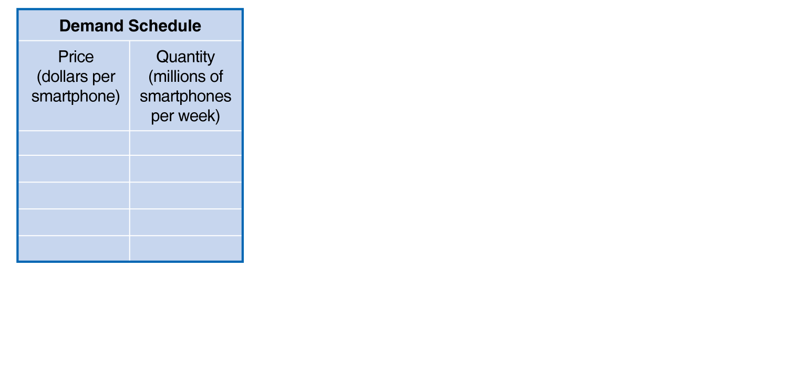
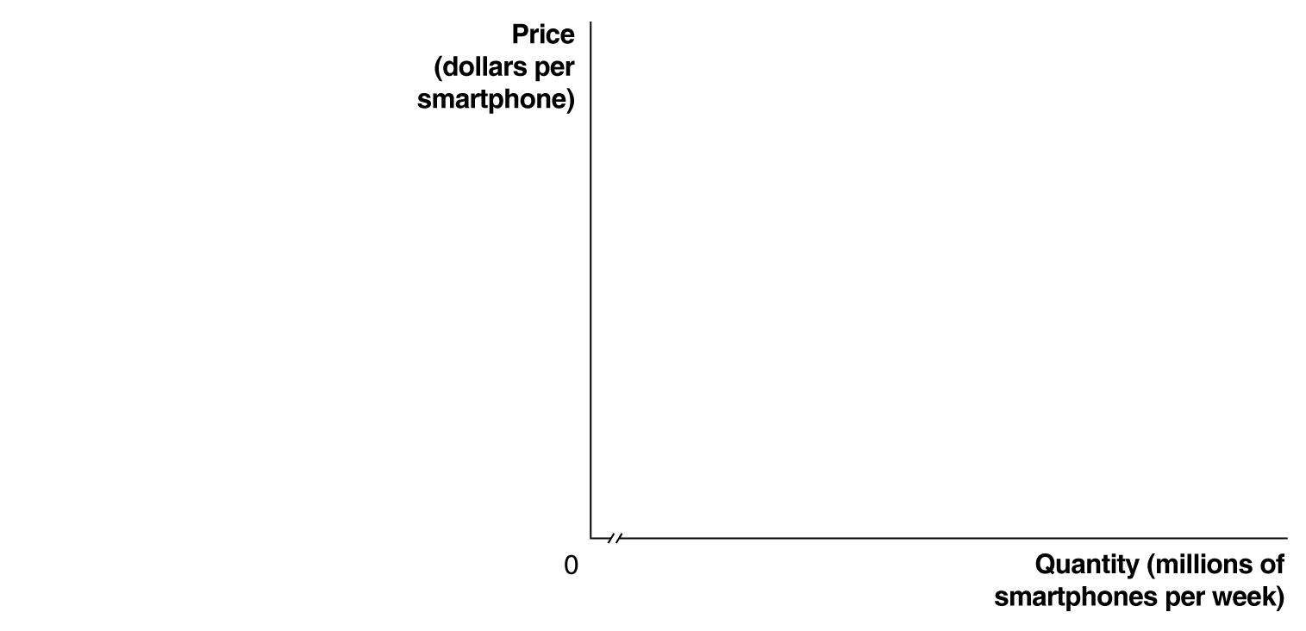

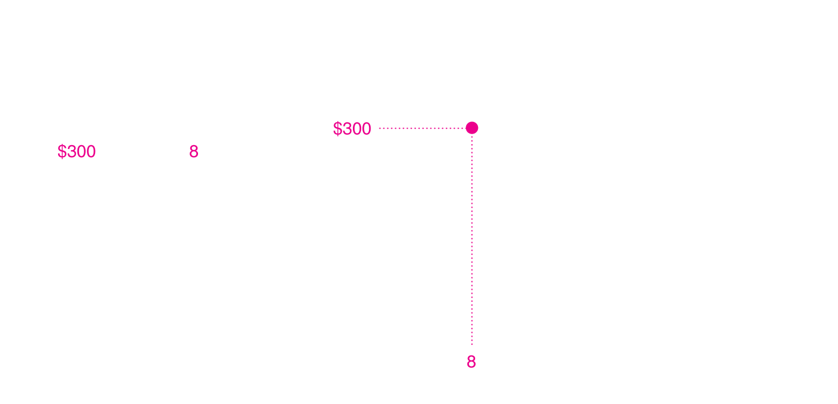
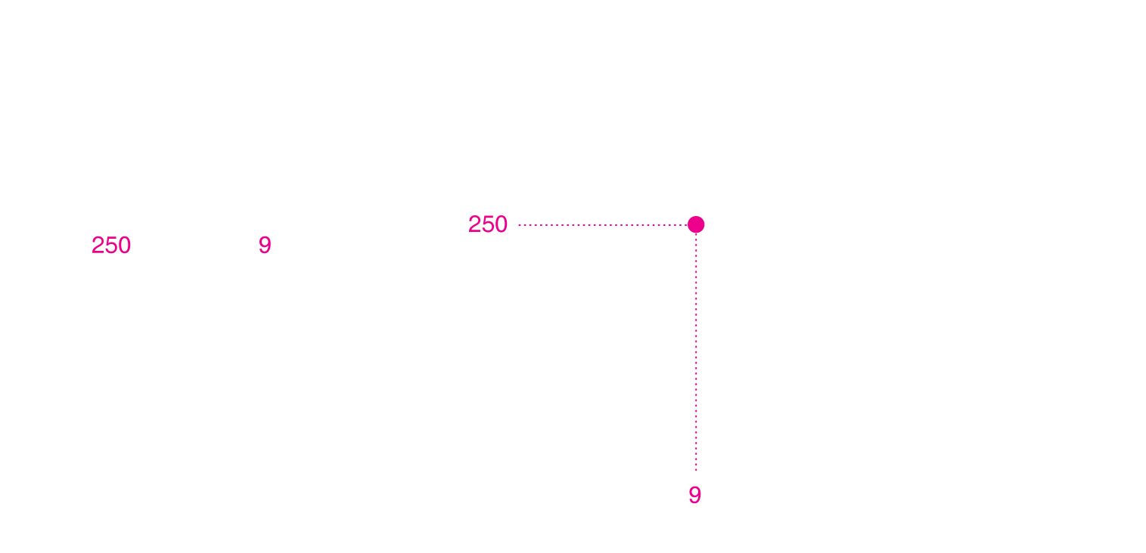
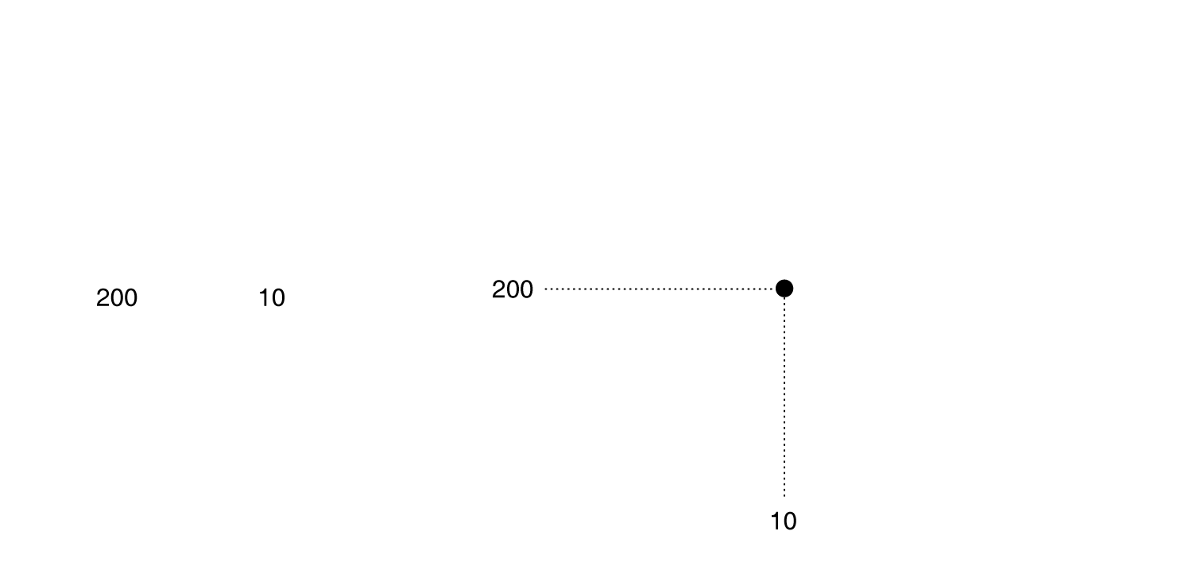
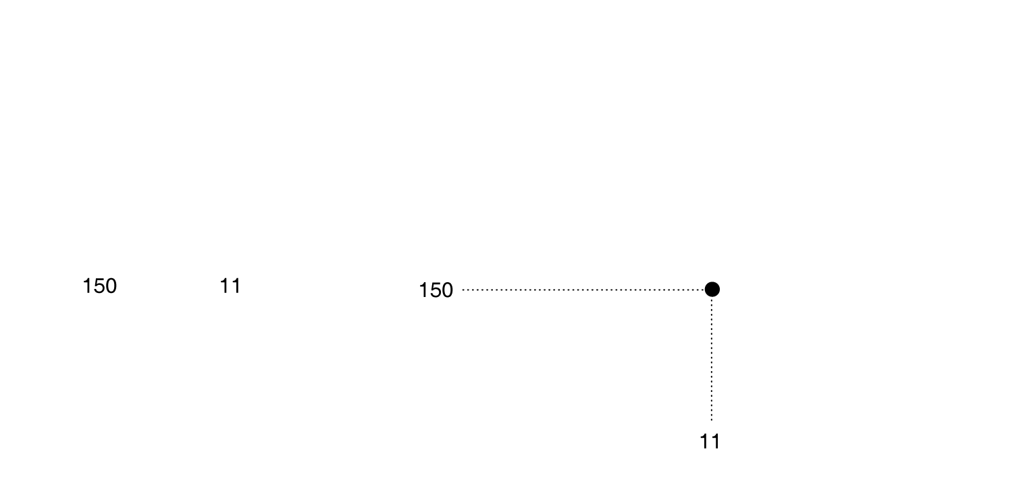
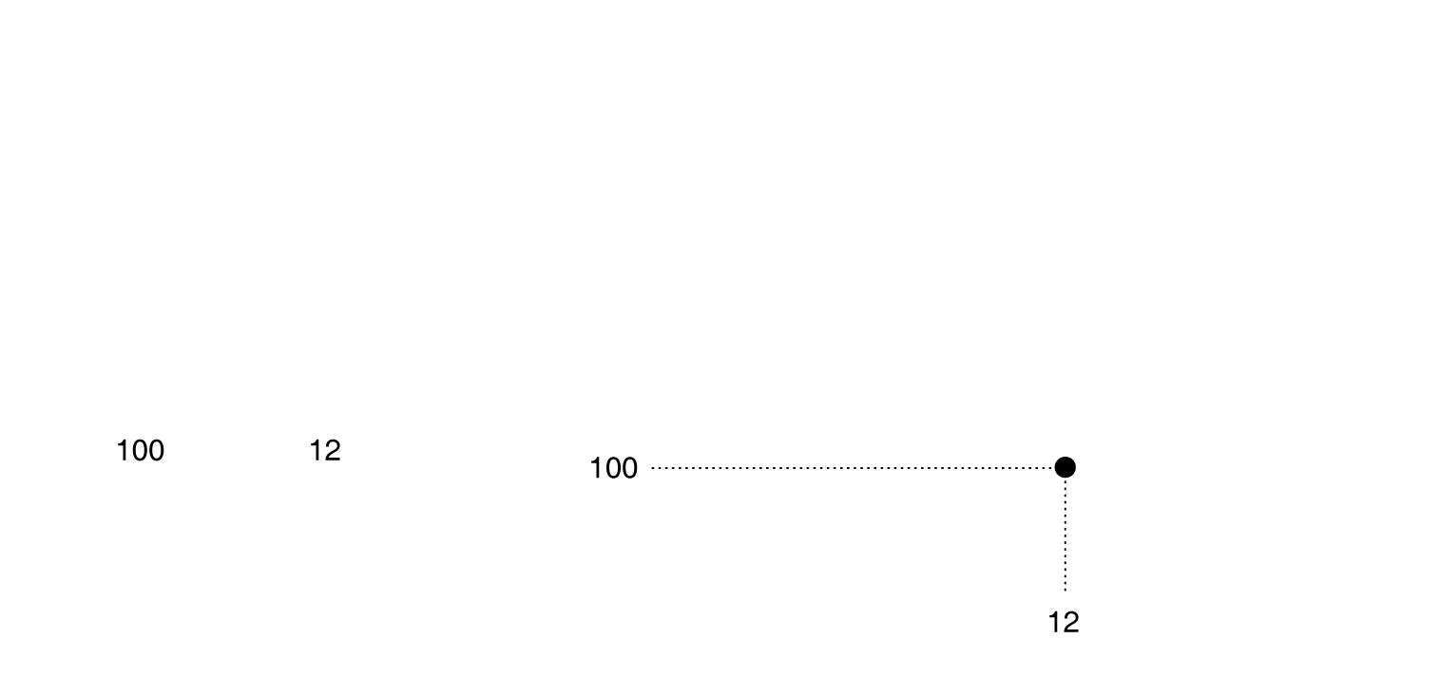
Demand schedule and demand curve
Demand Schedule: A table that shows the relationship between the price of a product and the quantity of the product demanded.
Demand Curve: A curve that shows the relationship between the price of a product and the quantity of the product demanded.
Figure 3.1
A demand schedule and a demand curve
Notes:
As the price changes, consumers change
the quantity of smartphones they are willing
to buy. We can show this as a demand
schedule in a table or as a demand curve
on a graph. The table and graph both show
that as the price of smartphones falls, the
quantity demanded increases. When the
price of smartphones is $300, consumers
buy 8 million smartphones per week.
When the price falls to $250, consumers buy
9 million. Therefore, the demand curve for
smartphones
is downward sloping.

Slide 6
Ceteris paribus
When drawing the demand curve, we assume ceteris paribus.
Ceteris paribus (“all else equal”) condition: The requirement that when analyzing the relationship between two variables—such as price and quantity demanded—other variables must be held constant.
Figure 3.1
A demand schedule and a demand curve

Slide 7
The law of demand
Law of Demand: The rule that, holding everything else constant, when the price of a product falls, the quantity demanded of the product will increase, and when the price of a product rises, the quantity demanded of the product will decrease.
Implication: Demand curve slopes downward
Figure 3.1
A demand schedule and a demand curve

Slide 8
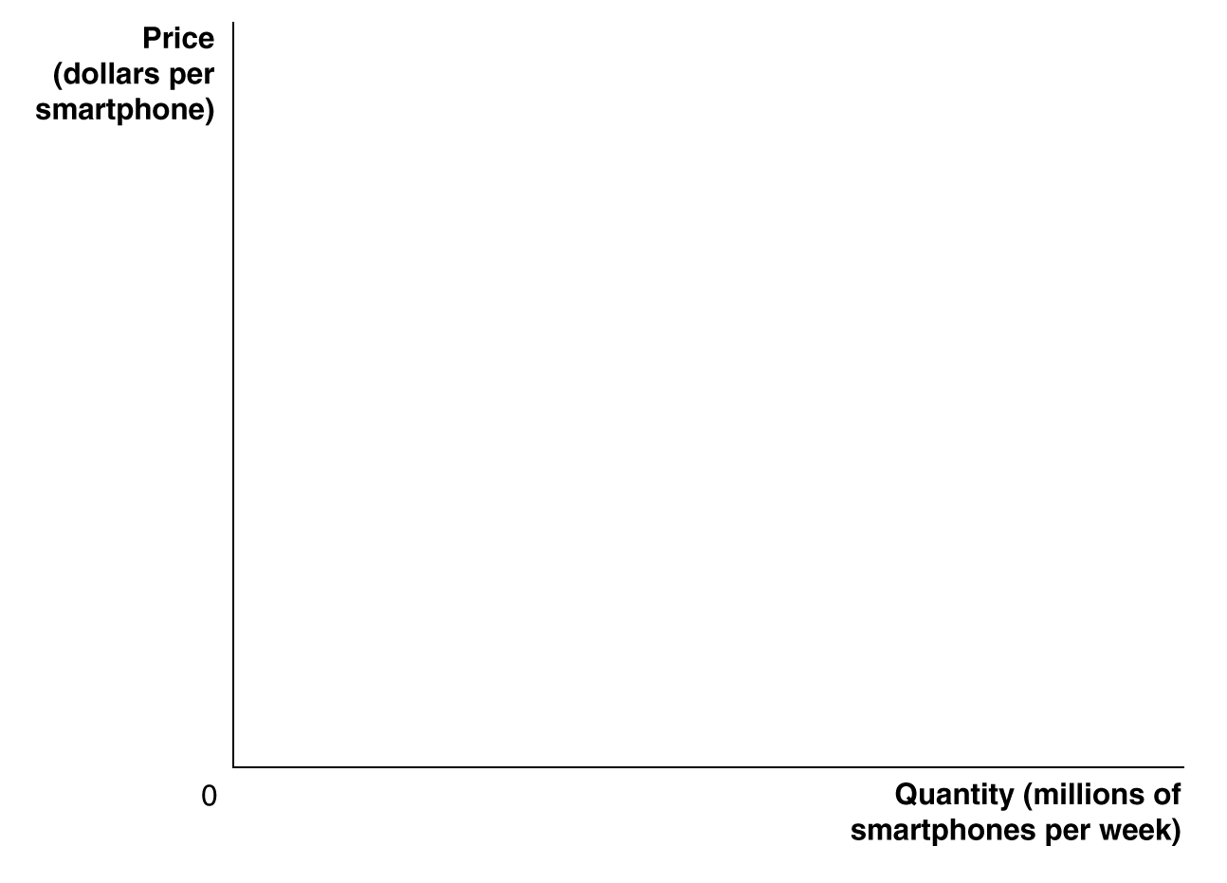
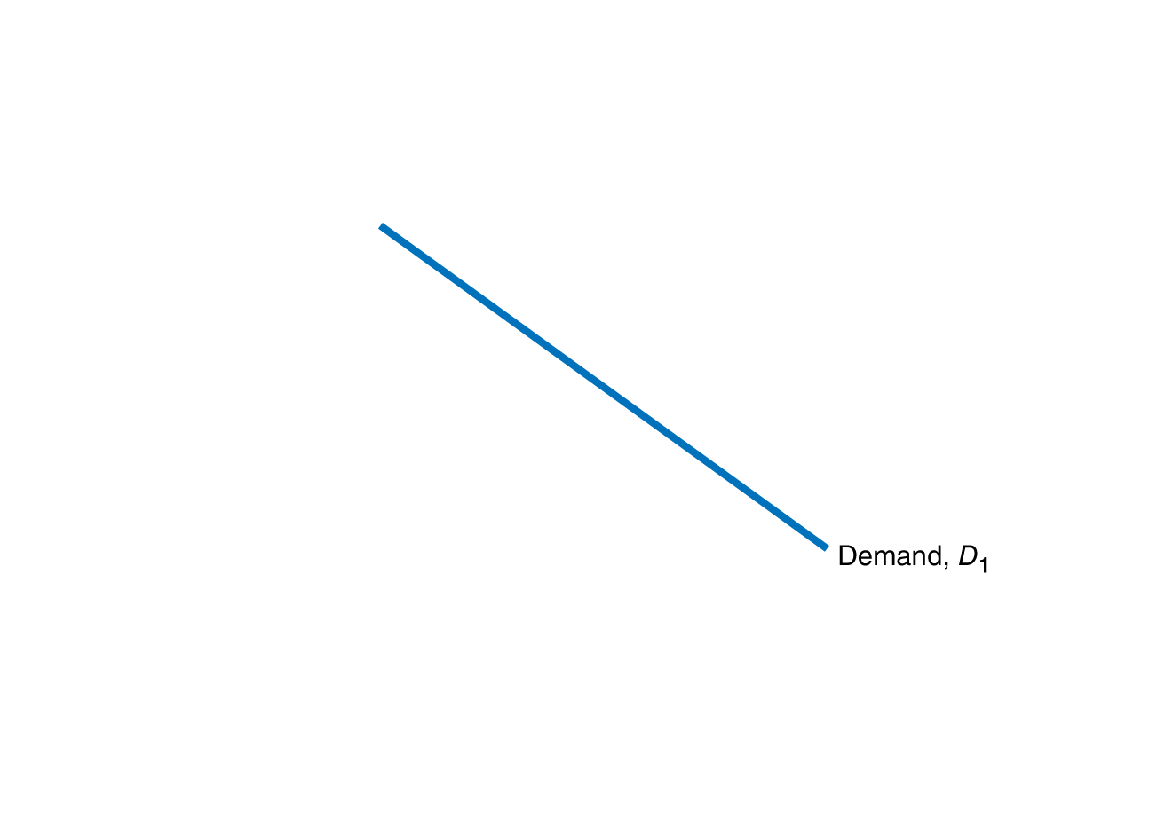
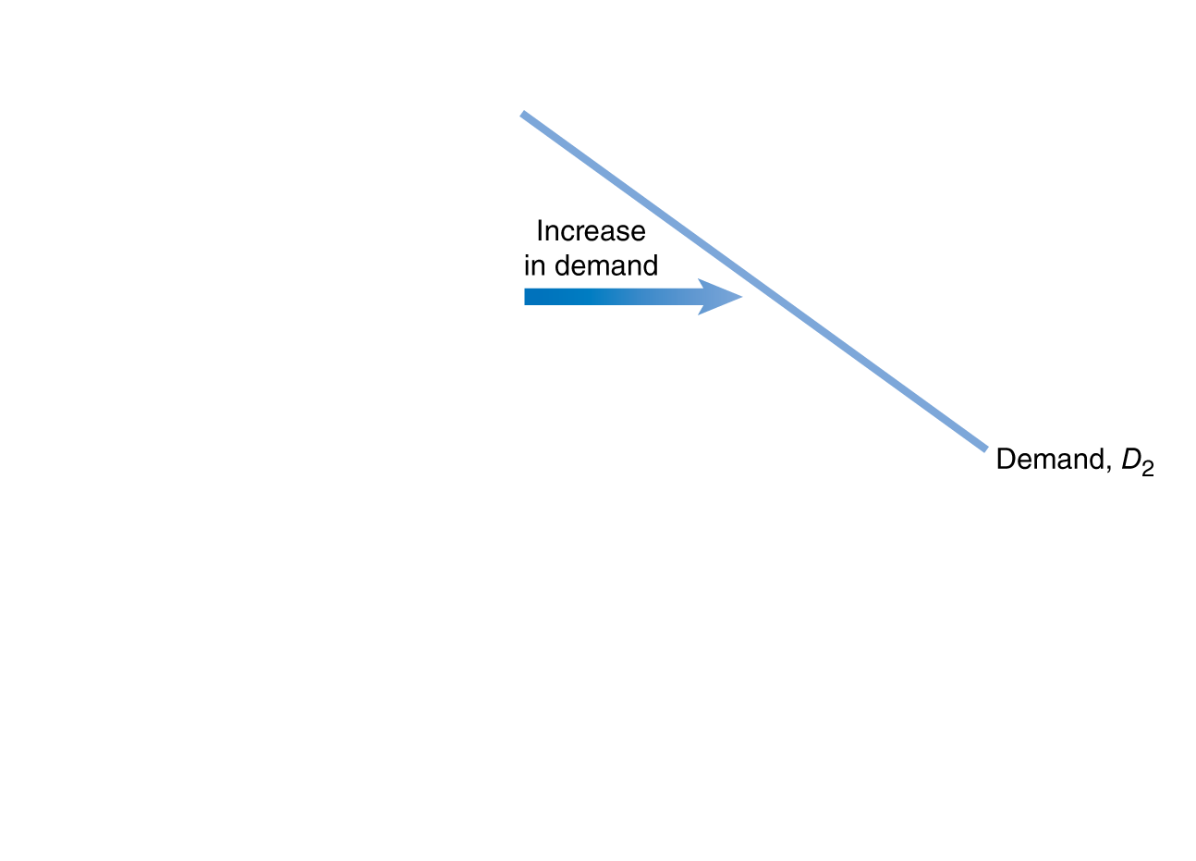
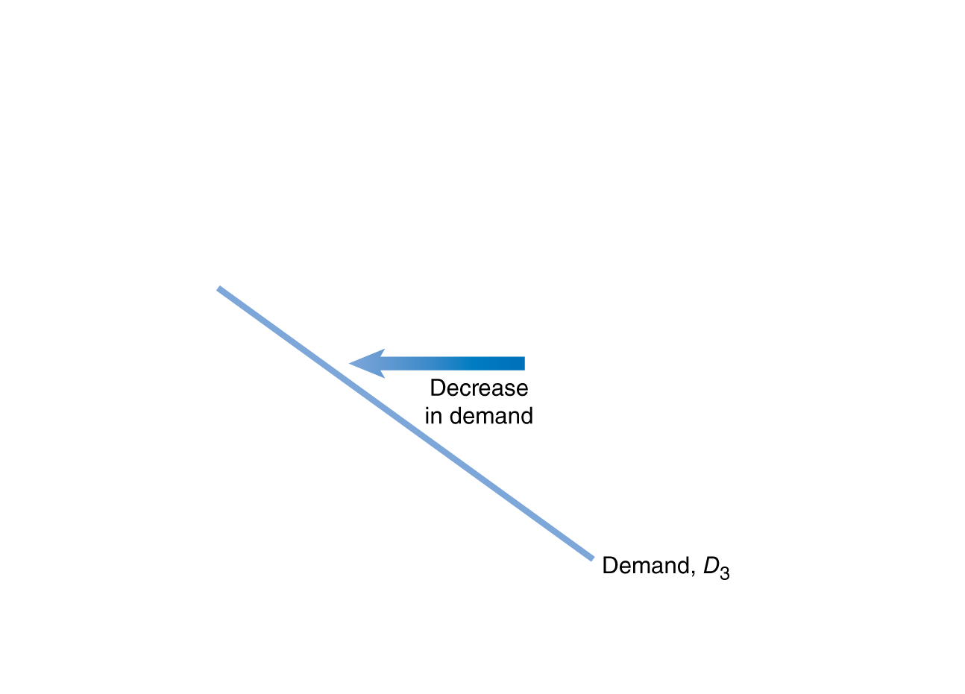
Increase and decrease in demand
A change in something other than price that affects demand causes the entire demand curve to shift.
A shift to the right (D₁ to D₂) is an increase in demand.
A shift to the left (D₁ to D₃) is a decrease in demand.
Figure 3.2
Shifting the demand curve
Notes:
When consumers increase the quantity of a product
they want to buy at a given price, the demand
curve shifts to the right, from D1 to D2. When
consumers decrease the quantity of a product they
want to buy at a given price, the demand curve
shifts to the left, from D1 to D3.

Slide 9
Shifts of the demand curve
As the demand curve shifts, the quantity demanded will change, even if the price doesn’t change.
The quantity demanded changes at every possible price.
P₁
Q₂ Q₁ Q₃
Figure 3.2
Shifting the demand curve

Slide 10
What factors influence market demand?
  Income of consumers
  Increase in income increases demand if product is normal, decreases demand if product is inferior.
  Prices of related goods
  Increase in price of related good increases demand if products are substitutes, decreases demand if products are complements
  Tastes
  Population and demographics
  Expected future prices
  We will discuss how each of these affects demand.

Slide 11


Change in income of consumers
  Normal goods:
  Goods for which the demand increases as income rises, and decreases as income falls.
  Examples: Clothing
  Restaurant meals
  Vacations
  Inferior goods:
  Goods for which the demand decreases as income rises, and increases as income falls.
  Examples: Second-hand clothing
  Ramen noodles
  Are smartphones normal or inferior goods?
Effect of increase in income, if good is normal
Effect of increase in income, if good is inferior

Slide 12
Change in the price of related goods
  Substitutes:
  Goods and services that can be used for
  the same purpose.
  Examples: Big Mac and Whopper
  Ford F-150 and Dodge Ram
  Jeans and Khakis
  Complements:
  Goods and services that are consumed together.
  Examples: Big Mac and McDonald’s fries
  Hot dogs and hot dog buns
  Left shoes and right shoes
Effect on demand for Big Macs, if price of Whopper increases
Effect on demand for Big Macs, if price of McDonald’s fries increases

Slide 13

Are tablets substitutes for e-readers?
Tablet computers and e-readers are not identical products, but they are similar.
To see whether consumers view tablets
as substitutes for e-readers, we need
to look at data.
As tablets have become more popular
in the early 2010s, worldwide sales of
e-readers have fallen:
2011: 23 million
2012: 16 million
2013: 5.8 million (forecast)
It seems consumers have decided that tablets are a close substitute for e-readers.

Slide 14
Change in tastes or population/demographics
  Tastes
  If consumers’ tastes change, they may buy more or less of the product.
  Example:
  If consumers become more concerned about eating healthily, they might decrease their demand for fast food.
  Population and demographics
  Increases in the number of people buying something will increase the amount demanded.
  Example: An increase in the elderly population increases the demand for medical care.
Effect on demand for fast food, if consumers want to eat healthy
Effect on demand for medical care, as the population ages

Slide 15
Change in expectations about future prices
  Consumers decide which products to buy and when to buy them.
  Future products are substitutes for current products
  An expected increase in the price tomorrow increases demand today.
  An expected decrease in the price tomorrow decreases demand today.
  Example: If you found out the price of gasoline would go up tomorrow, you would increase your demand today.
Effect on today’s gasoline demand, if price will rise tomorrow

Slide 16
Apple’s policy on product speculation
Apple strongly discourages its employees from speculating about when a new model will appear. Why?
Suppose a customer learns that a new iPad model will be available next month.
The new model is a potential substitute for the current model.
The price of the current model will likely fall next month.
Both effects decrease current demand (bad for Apple!).

Slide 17
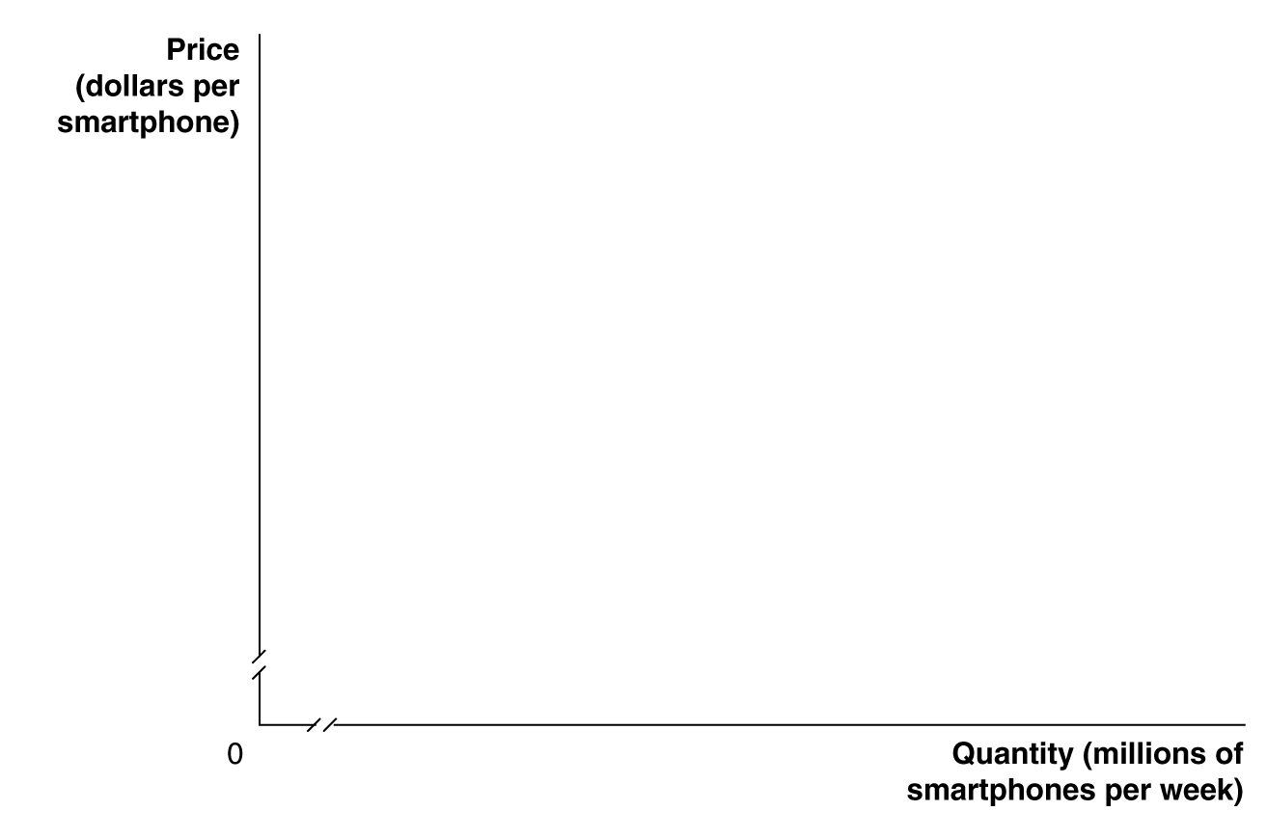
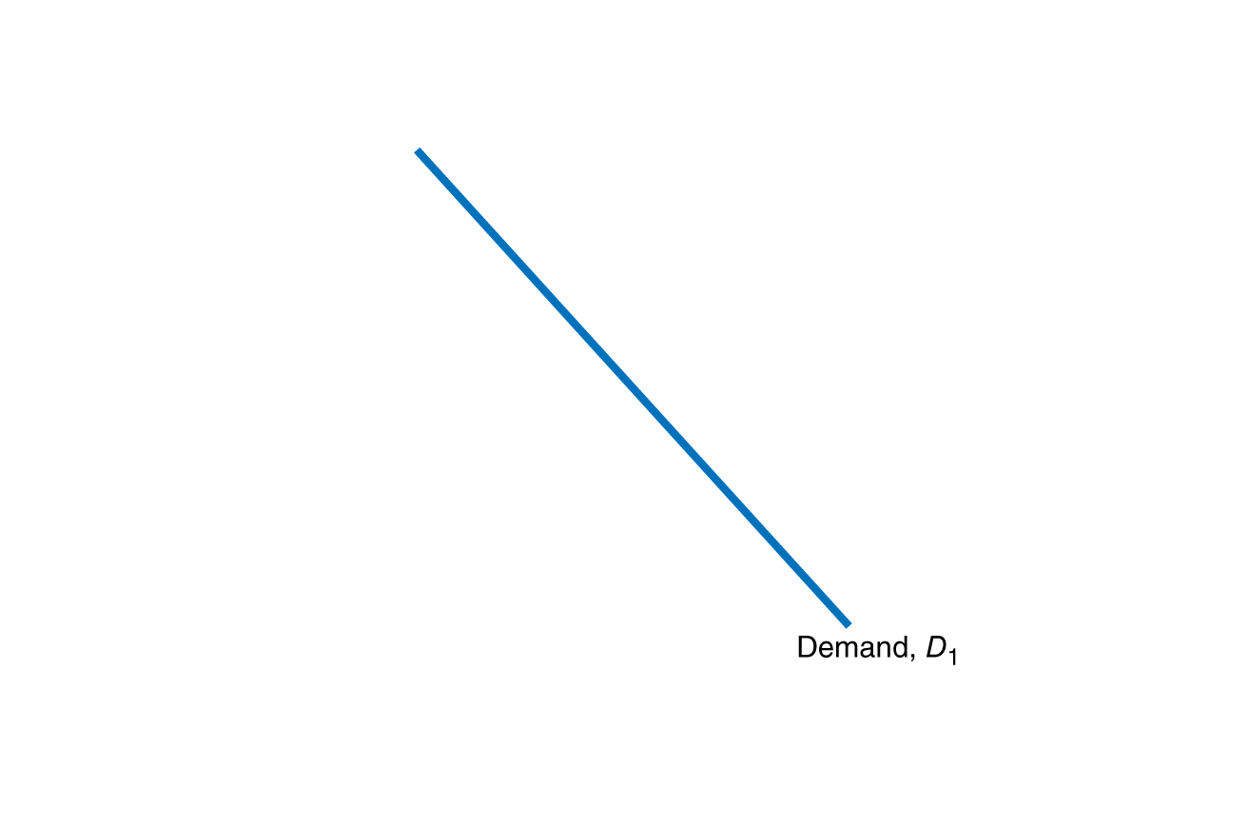
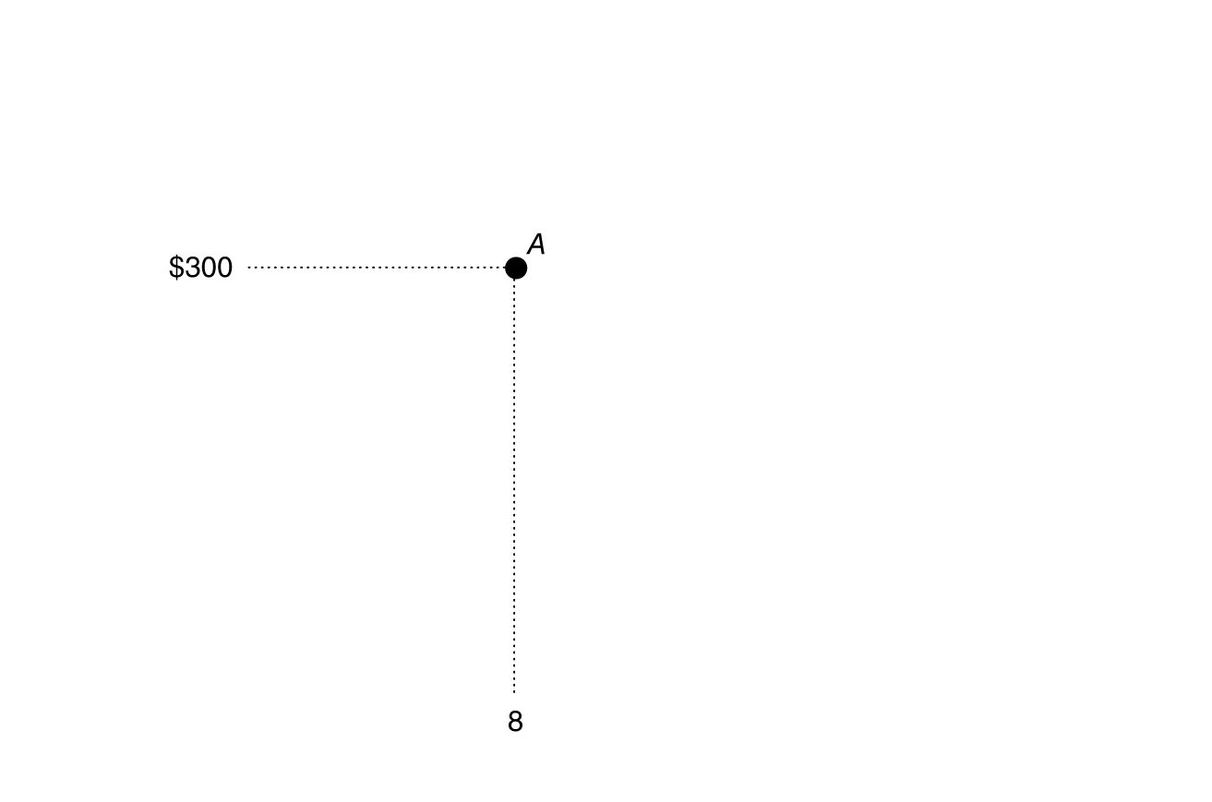
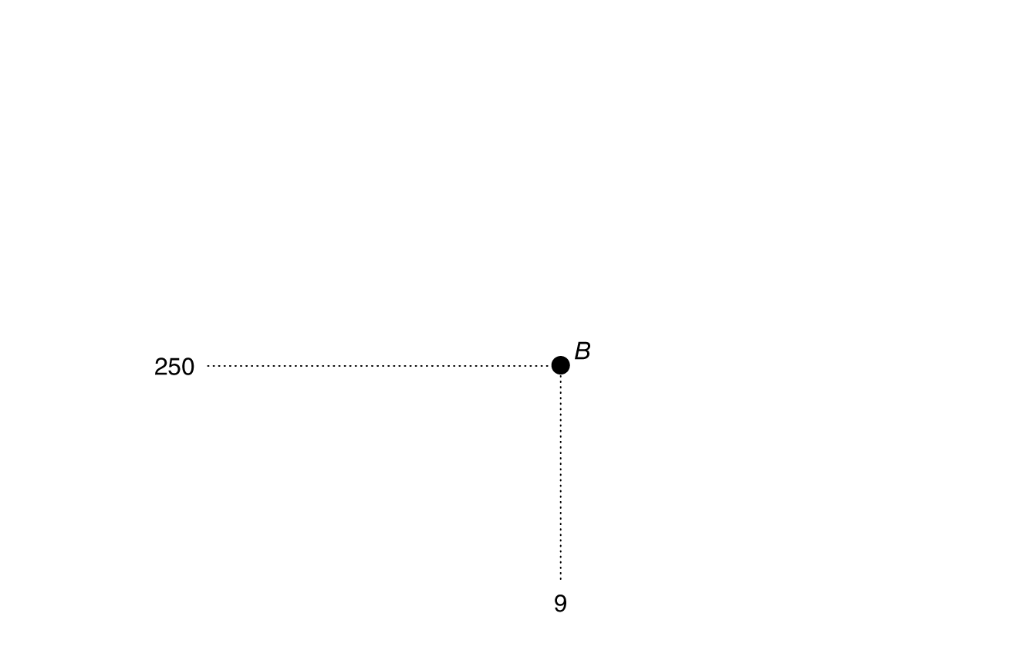

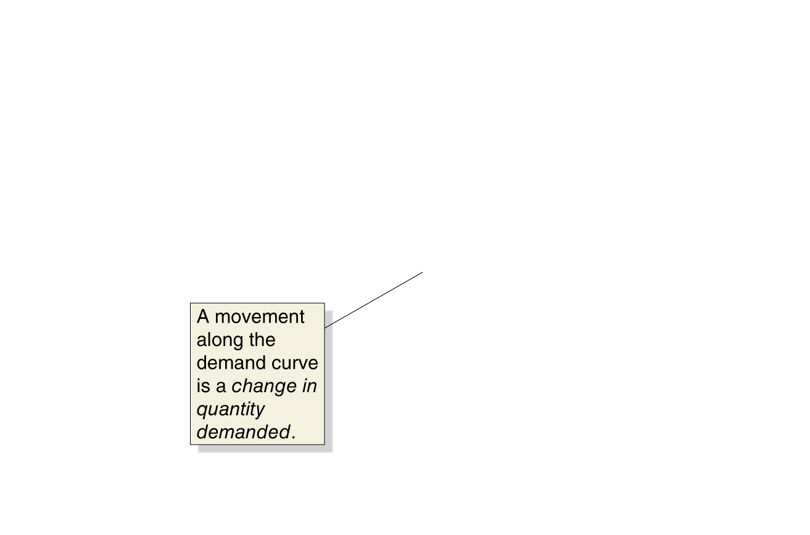
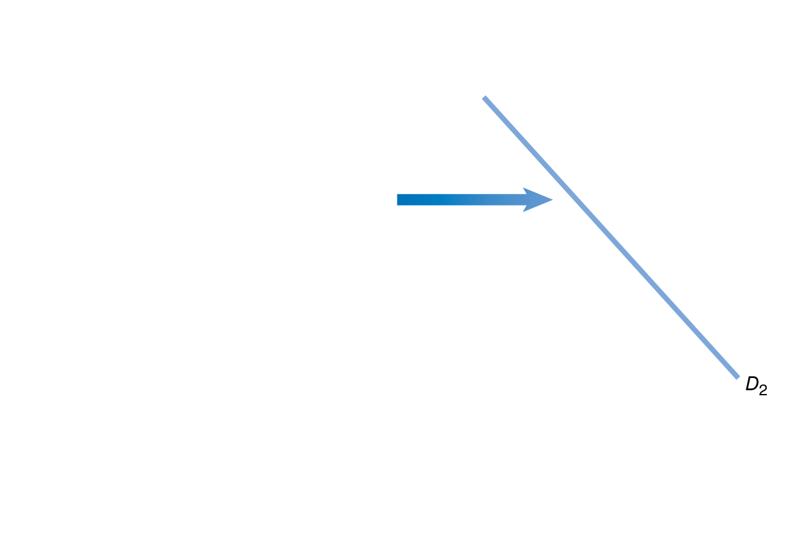
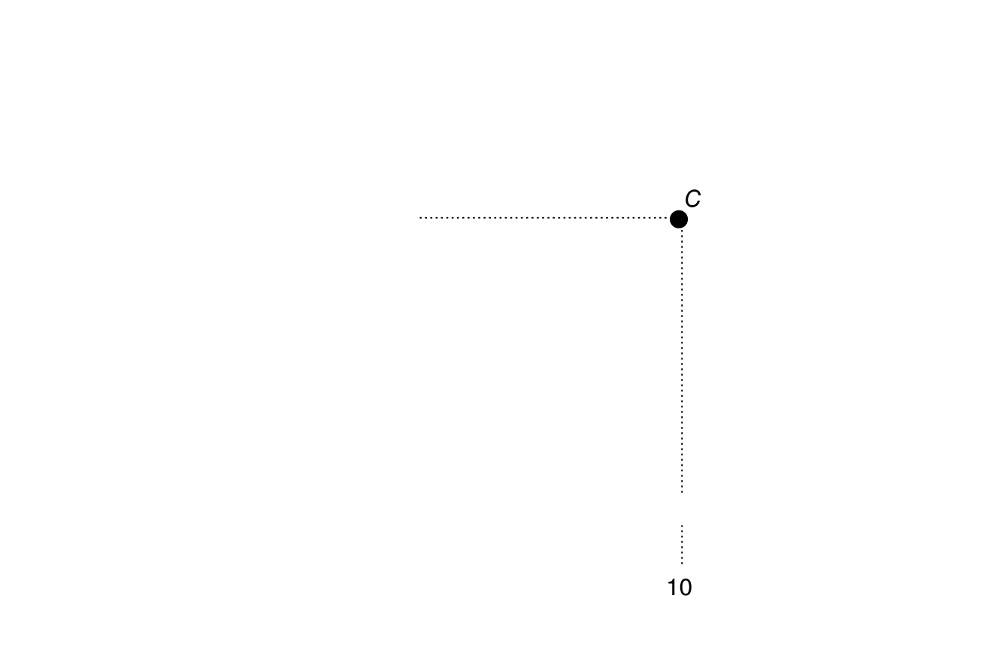
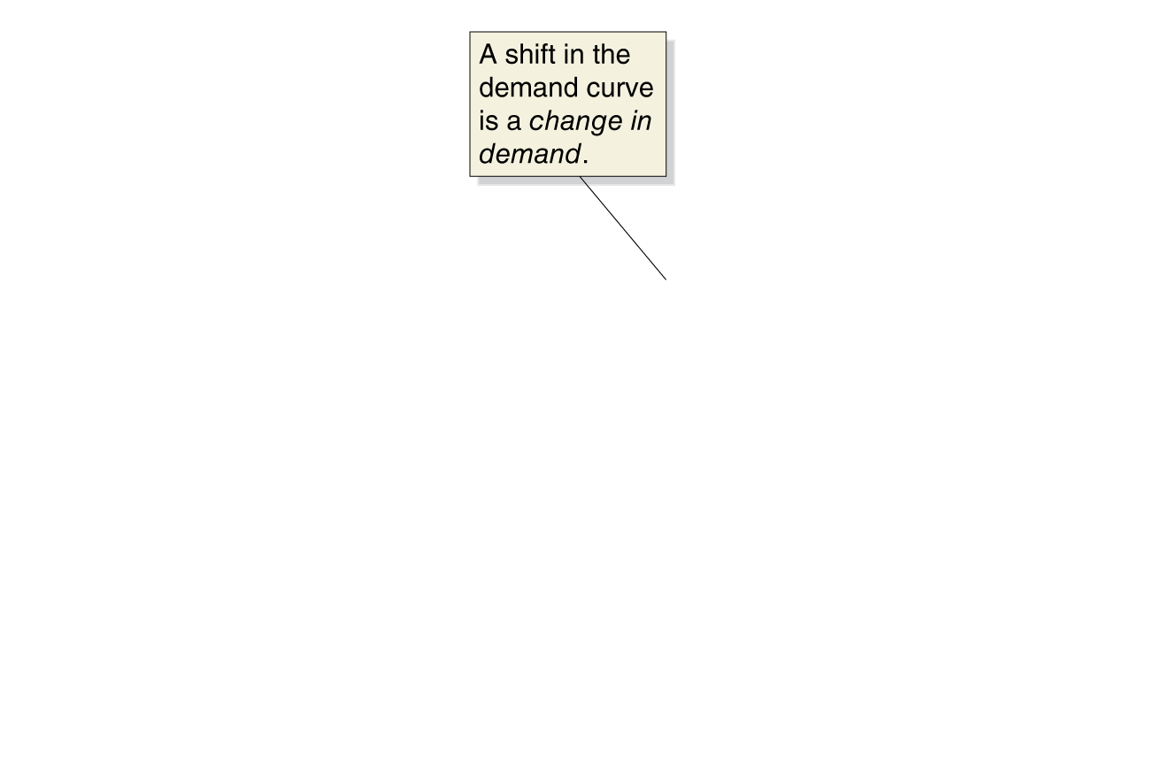
Change in demand vs. change in quantity demanded
A change in the price of the product being examined causes a movement along the demand curve.
This is a change in quantity demanded.
Any other change affecting demand causes the entire demand curve to shift.
This is a change in demand.
Figure 3.3
A change in demand versus a change in quantity demanded
Notes:
If the price of smartphones falls from $300
to $250, the result will be a movement
along the demand curve from point A to
point B—an increase in quantity demanded
from 8 million to 9 million. If consumers’
incomes increase, or if another factor
changes that makes consumers want more
of the product at every price, the demand
curve will shift to the right—an increase
in demand. In this case, the increase in demand
from D1 to D2 causes the quantity of
smartphones demanded at a price of $300
to increase from 8 million at point A to
10 million at point C.

Slide 18
The Supply Side of the Market
3.2
Discuss the variables that influence supply.

Slide 19
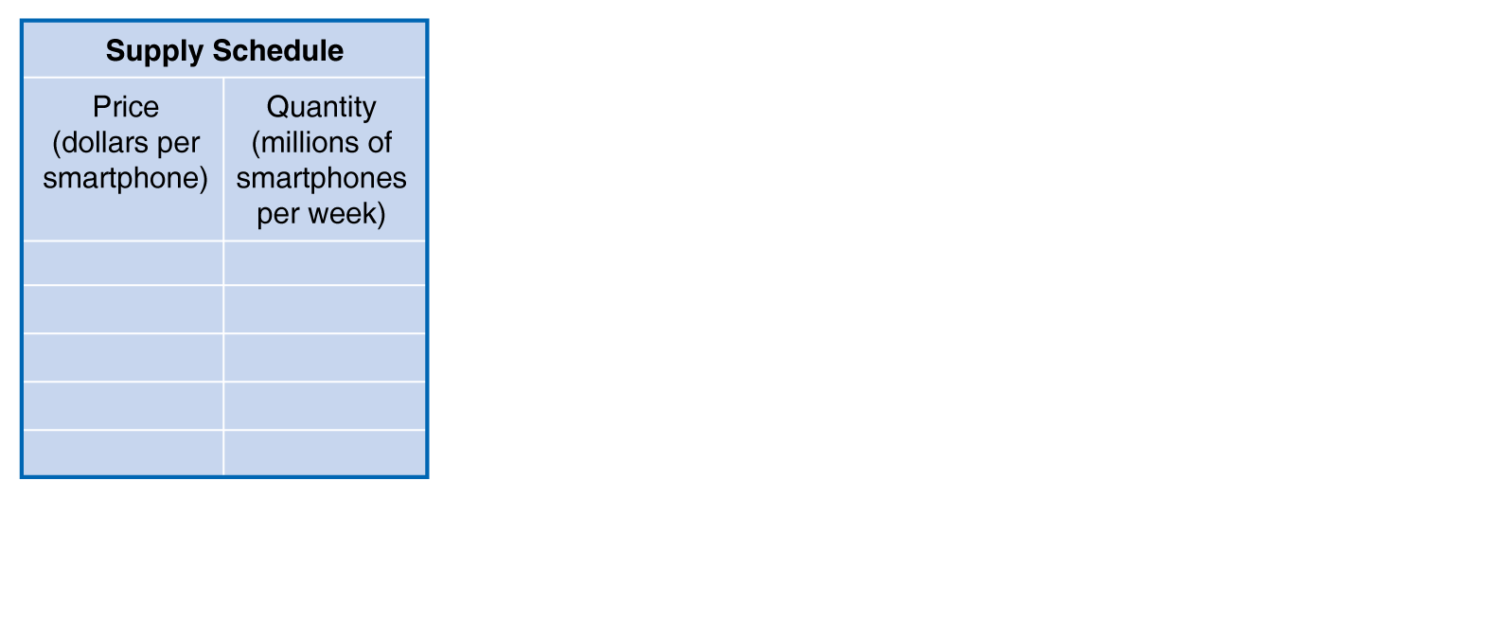
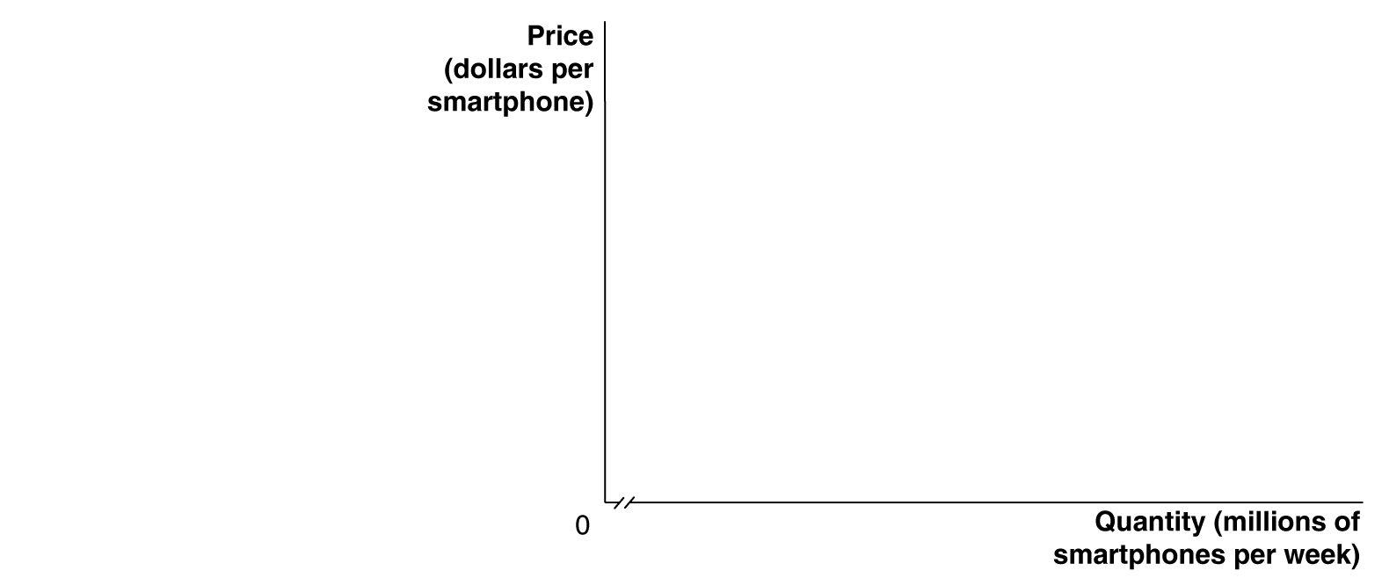

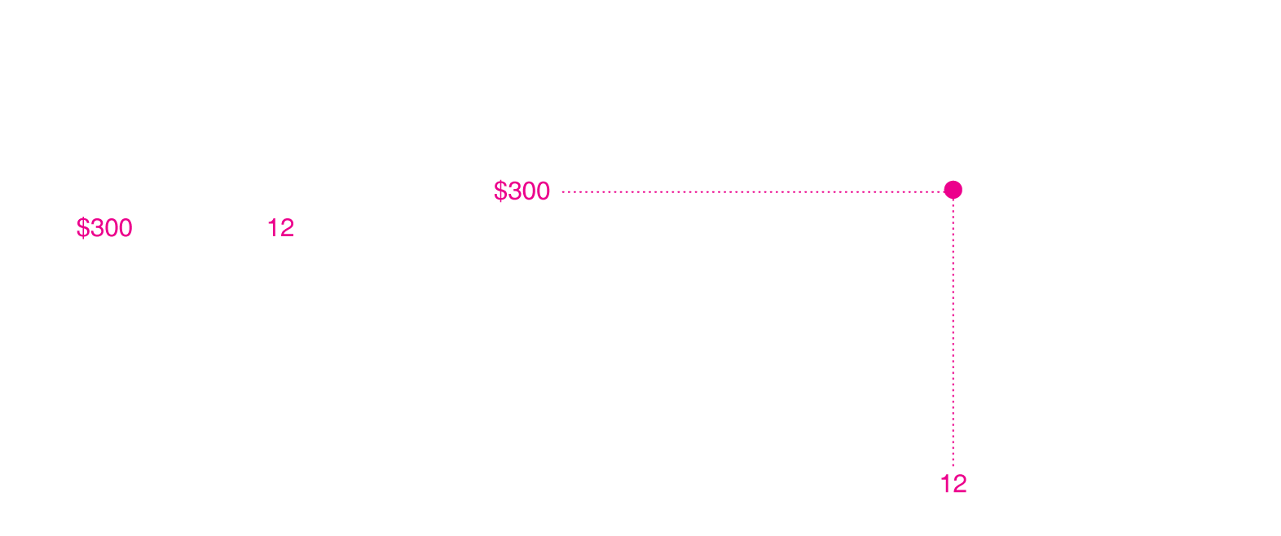
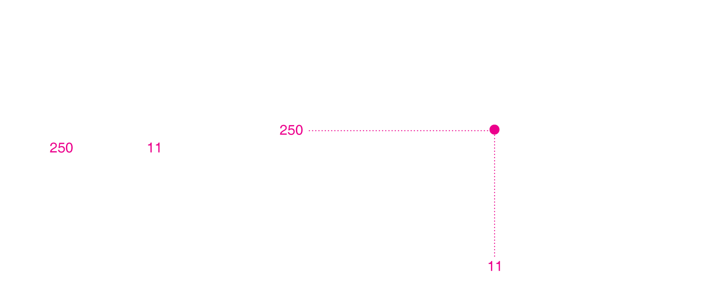
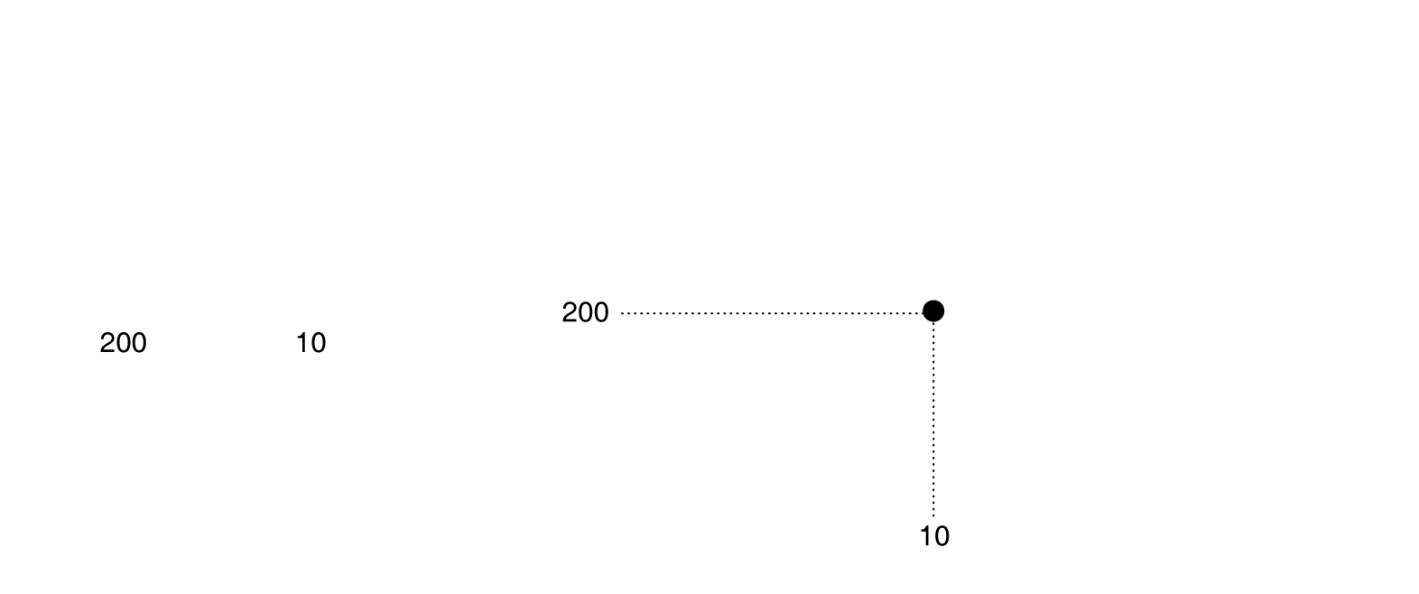
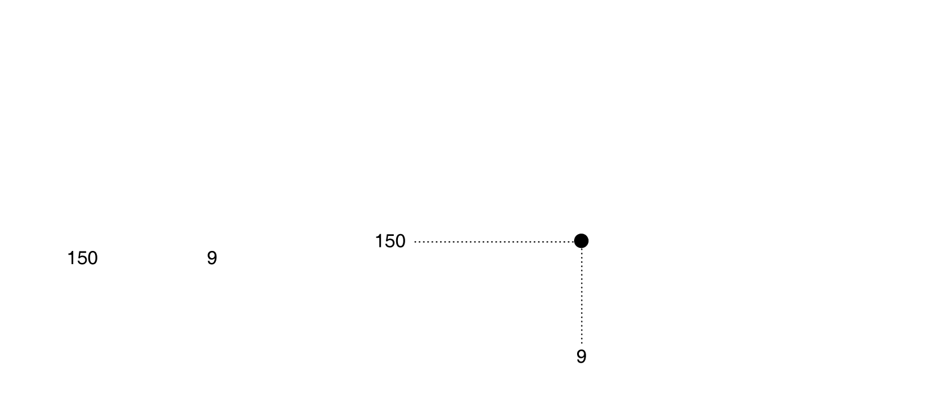


Supply schedule and supply curve
Supply Schedule: A table that shows the relationship between the price of a product and the quantity of the product supplied.
Supply Curve: A curve that shows the relationship between the price of a product and the quantity of the product supplied.
Figure 3.4
A supply schedule and a supply curve
Notes:
As the price changes, Apple, Samsung, LG,
and other firms producing smartphones
change the quantity they are willing to supply.
We can show this as a supply schedule
in a table or as a supply curve on a graph.
The supply schedule and supply curve both
show that as the price of smartphones rises,
firms will increase the quantity they supply.
At a price of $250 per smartphone, firms will
supply 11 million smartphones per week. At
a price of $300, firms will supply 12 million.

Slide 20
The law of supply
The law of supply: The rule that, holding everything else constant, increases in price cause increases in the quantity supplied, and decreases in price cause decreases in the quantity supplied.
Implication: supply curves slope upward.
Figure 3.4
A supply schedule and a supply curve

Slide 21
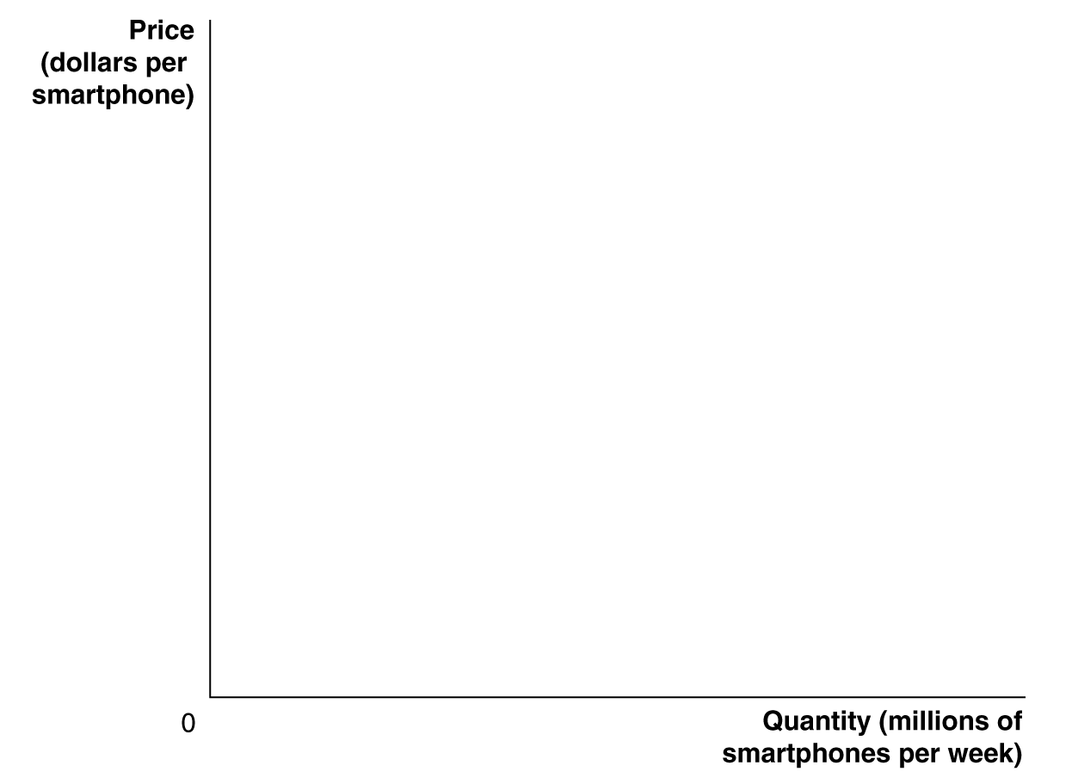
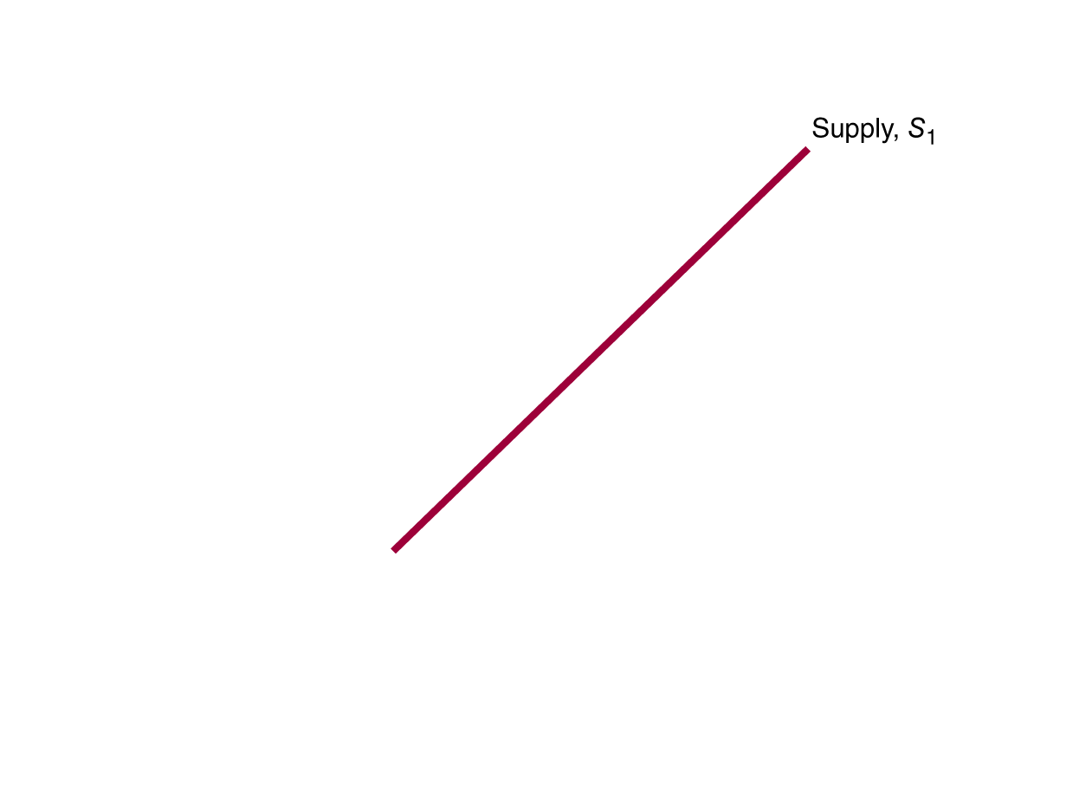
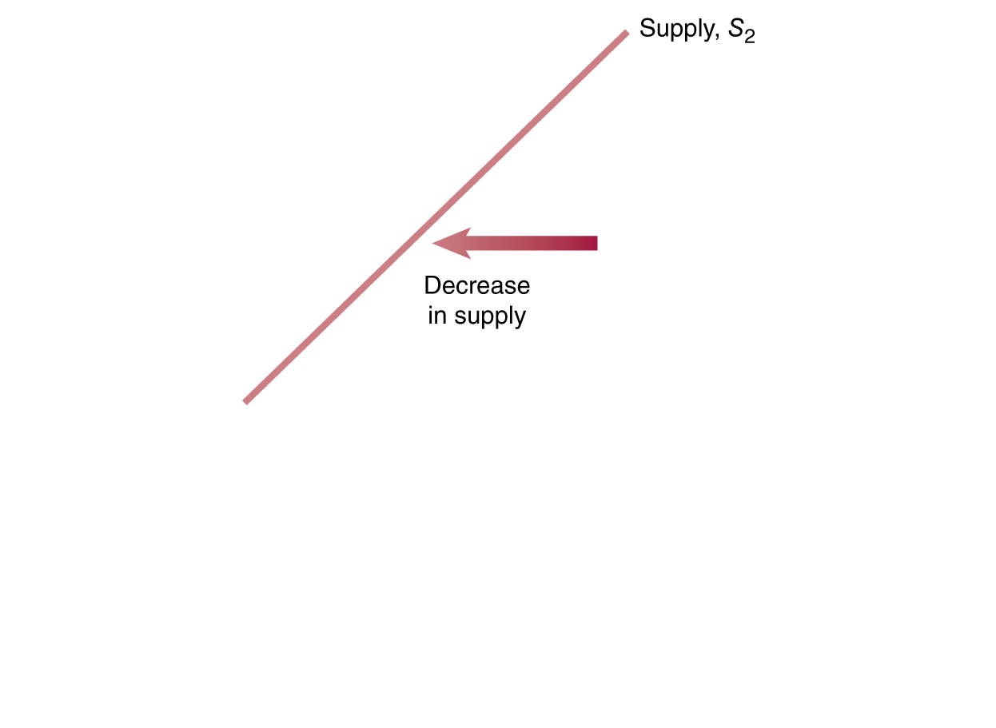
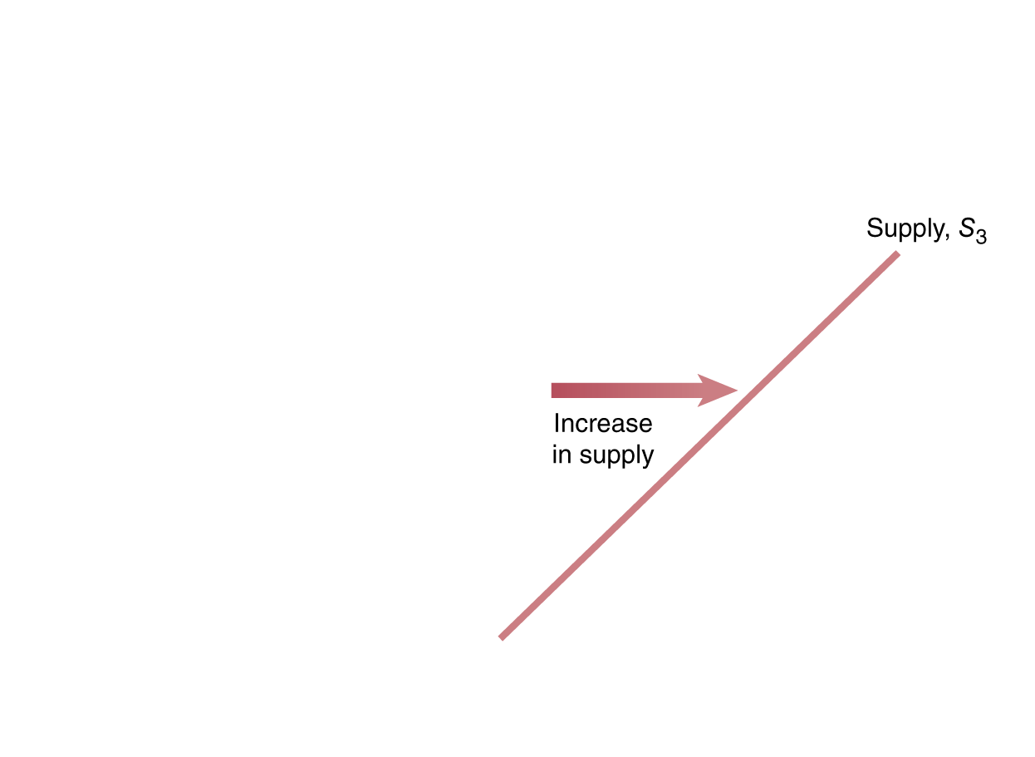
Increase and decrease in supply
A change in something other than price that affects supply causes the entire supply curve to shift.
A shift to the right (S₁ to S₃) is an increase in supply.
A shift to the left (S₁ to S₂) is a decrease in supply.
Figure 3.5
Shifting the supply curve
Notes:
When firms increase the quantity of a product
they want to sell at a given price, the
supply curve shifts to the right. The shift
from S1 to S3 represents an increase in supply.
When firms decrease the quantity of a
product they want to sell at a given price, the
supply curve shifts to the left. The shift from
S1 to S2 represents a decrease in supply.

Slide 22
Shifts of the supply curve
As the supply curve shifts, the quantity supplied will change, even if the price doesn’t change.
The quantity supplied changes at every possible price.
P₁
Q₂ Q₁ Q₃
Figure 3.5
Shifting the supply curve

Slide 23
Variables that shift market supply
  Prices of inputs
  Technological change
  Prices of substitutes in production
  Number of firms in the market
  Expected future prices
  We will discuss how each of these affects supply.

Slide 24
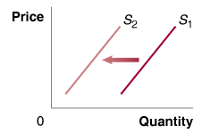

Changes in prices of inputs
  Inputs are things used in the production of a good or service.
  Examples of inputs for smartphones:
  Computer processor
  Plastic housing
  Labor
  An increase in the price of an input decreases the profitability of selling the good, causing a decrease in supply.
  A decrease in the price of an input increases the profitability of selling the good, causing an increase in supply.
Effect of an increase in the price of input goods
Effect of a decrease in the price of input goods

Slide 25
Technological change
  A firm may experience a positive or negative change in its ability to produce a given level of output with a given quantity of inputs. This is a technological change.
  Changes raise or lower firms’ costs, hence their supply of the good.
  Examples:
    A new, more productive variety of wheat would increase the supply of wheat.
    Governmental restrictions on land use for agriculture might decrease the supply of wheat.
Effect of a positive change in technology
Effect of a negative change in technology

Slide 26
Prices of substitutes, and number of firms
  Many firms can produce and sell more than one product.
  Example:
  An Illinois farmer can plant corn or soybeans. If the price of soybeans rises, he will plant (supply) less corn.
  More firms in the market will result in more product available at a given price (greater supply).
  Fewer firms → supply decreases.
Effect on the supply of corn, of an increase in the price of soybeans
Effect of a increase in the number of firms

Slide 27
Change in expected future prices
  If a firm anticipates the price of its product will be higher in the future, it might decrease its supply today in order to increase it in the future.
  What types of products could be “stored” like this?
  Perishable products, or
  Non-perishable products
Effect of an increase in future expected price of a good

Slide 28
Release timing of Collateral Damage
The Schwartzenegger film Collateral Damage was originally scheduled to be released on October 5, 2001.
The film contained plot elements about terrorist attacks.
The production company (Warner Bros.) decided the movie would have higher demand (higher expected future prices) if it did not show immediately after 9/11, so it was delayed until February 2002.

Slide 29
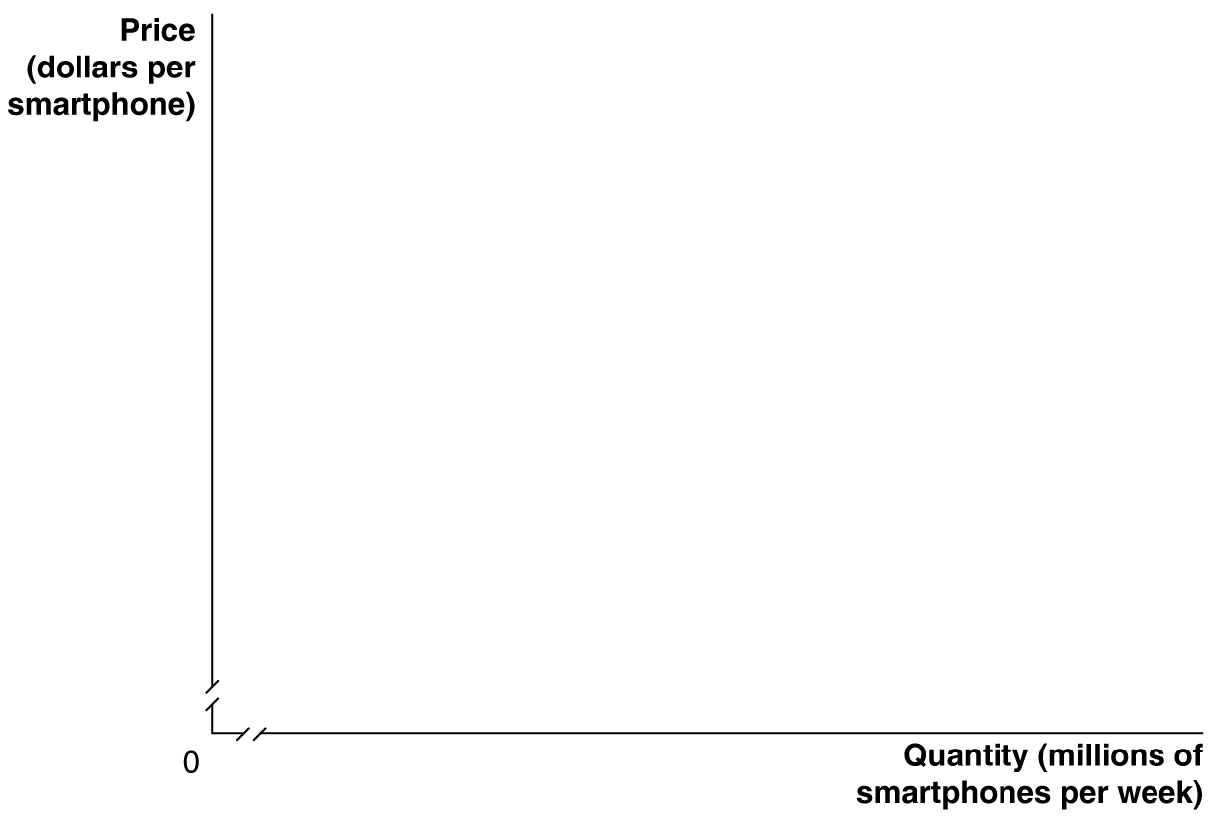
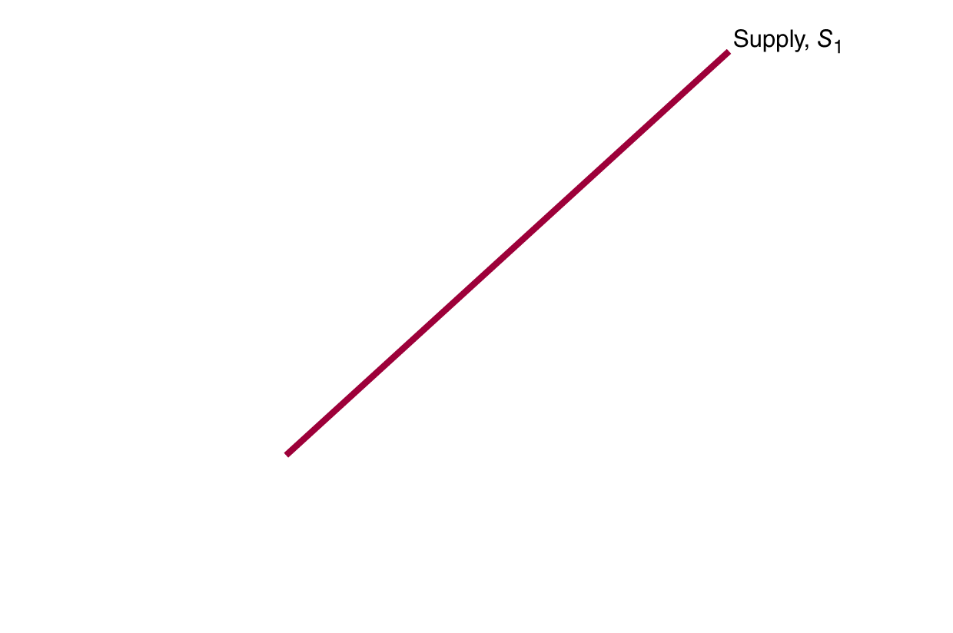
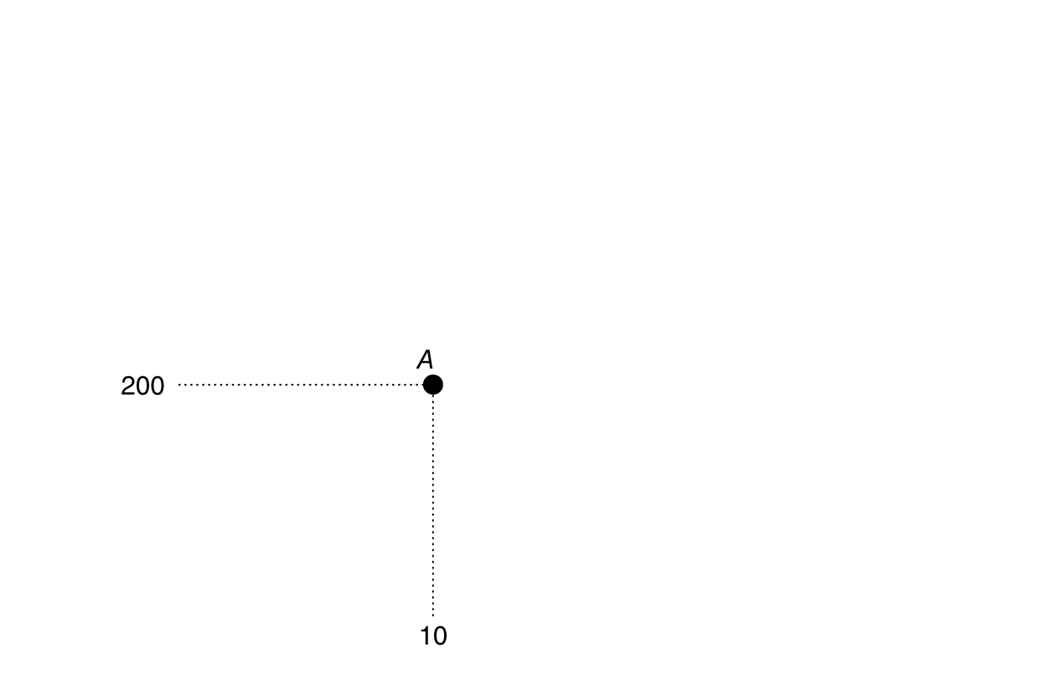
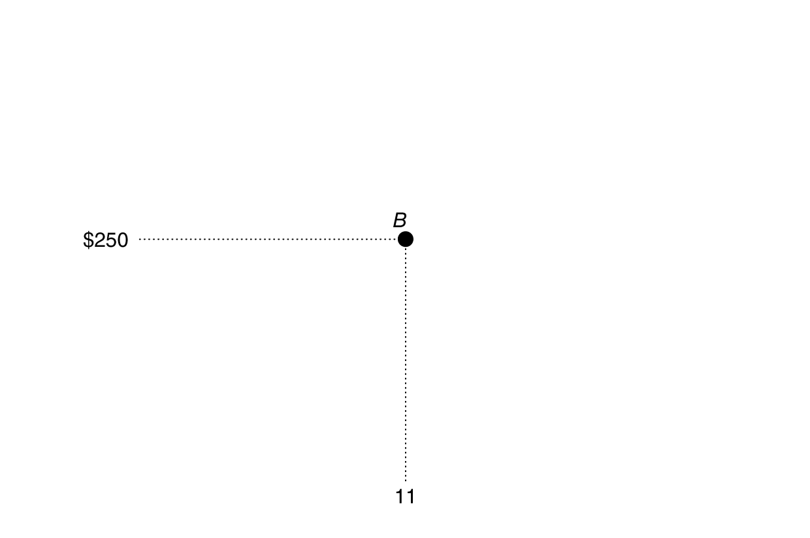

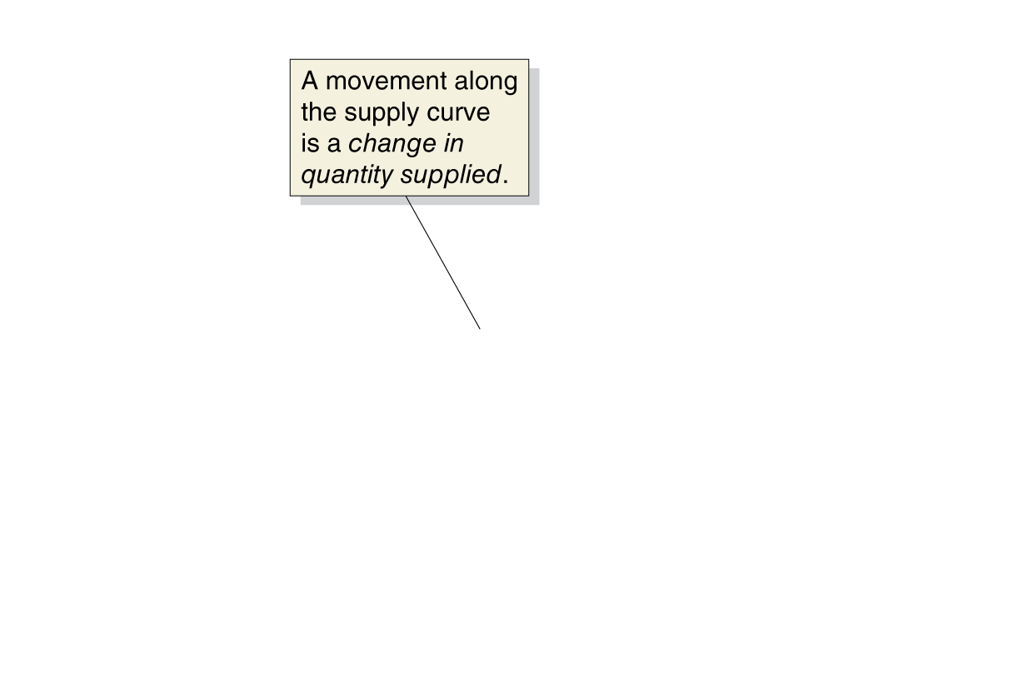
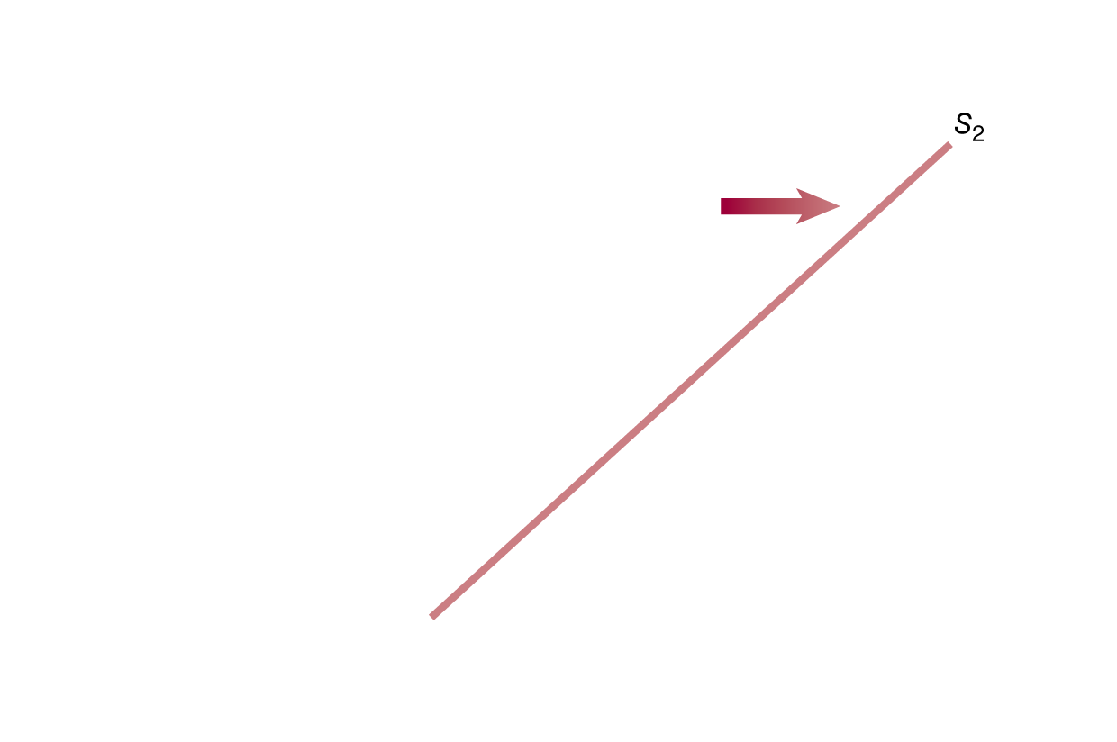
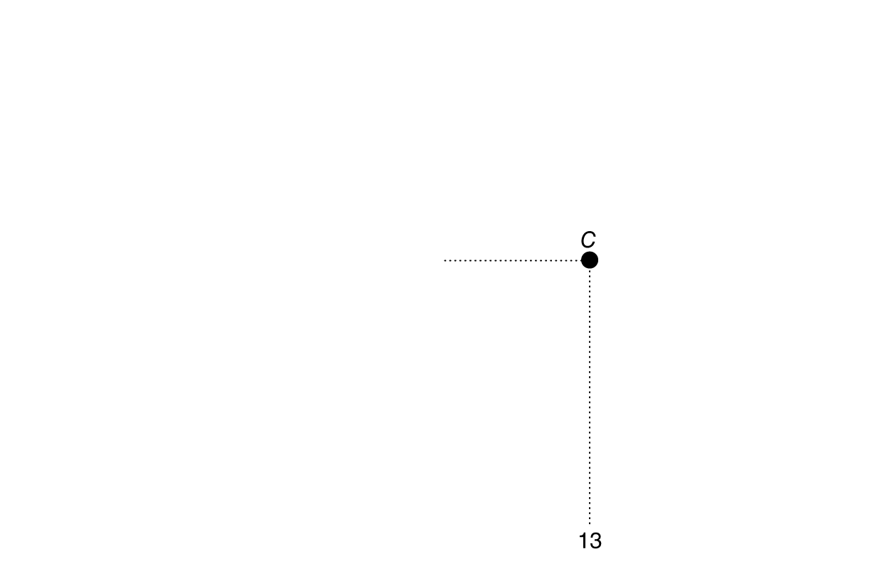
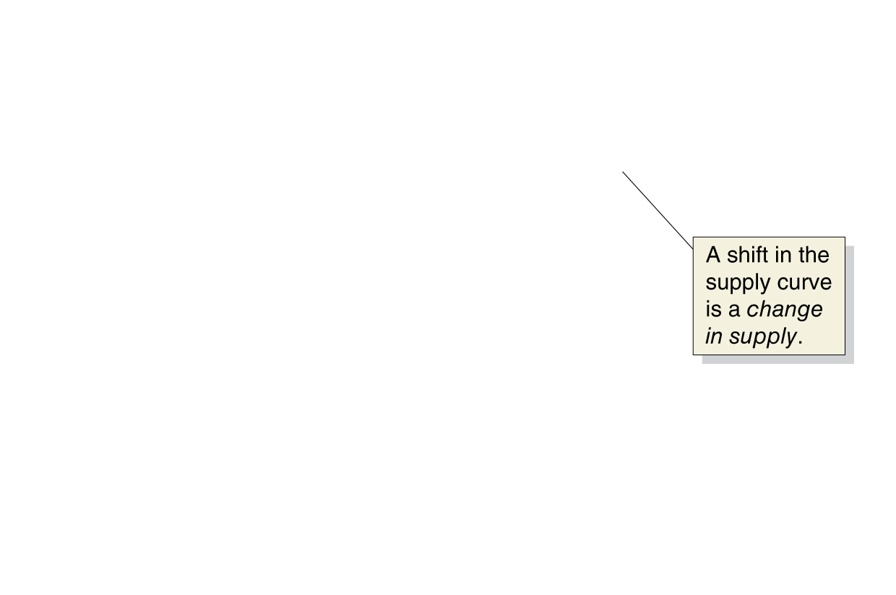
Change in supply vs. change in quantity supplied
A change in the price of the product being examined causes a movement along the supply curve.
This is a change in quantity supplied.
Any other change affecting supply causes the entire supply curve to shift.
This is a change in supply.
Figure 3.6
A change in supply versus a change in quantity supplied
Notes:
If the price of smartphones rises from $200
to $250, the result will be a movement up
the supply curve from point A to point B—
an increase in quantity supplied by Apple,
Samsung, Nokia, and other firms from
10 million to 11 million. If the price of an
input decreases, or if another factor changes
that causes sellers to supply more of the
product at every price, the supply curve will
shift to the right—an increase in supply. In
this case, the increase in supply from S1 to S2
causes the quantity of smartphones supplied
at a price of $250 to increase from 11 million
at point B to 13 million at point C.

Slide 30
Market Equilibrium: Putting Demand and Supply Together
3.3
Use a graph to illustrate market equilibrium.

Slide 31
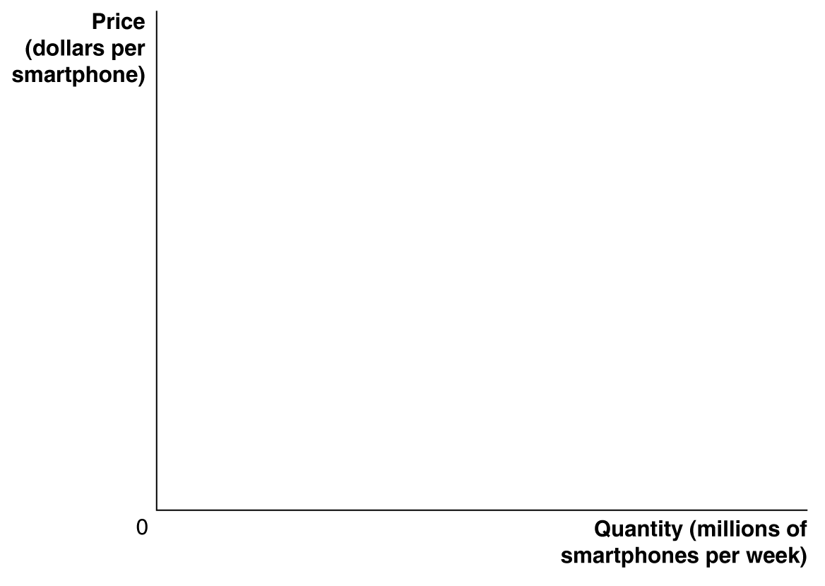
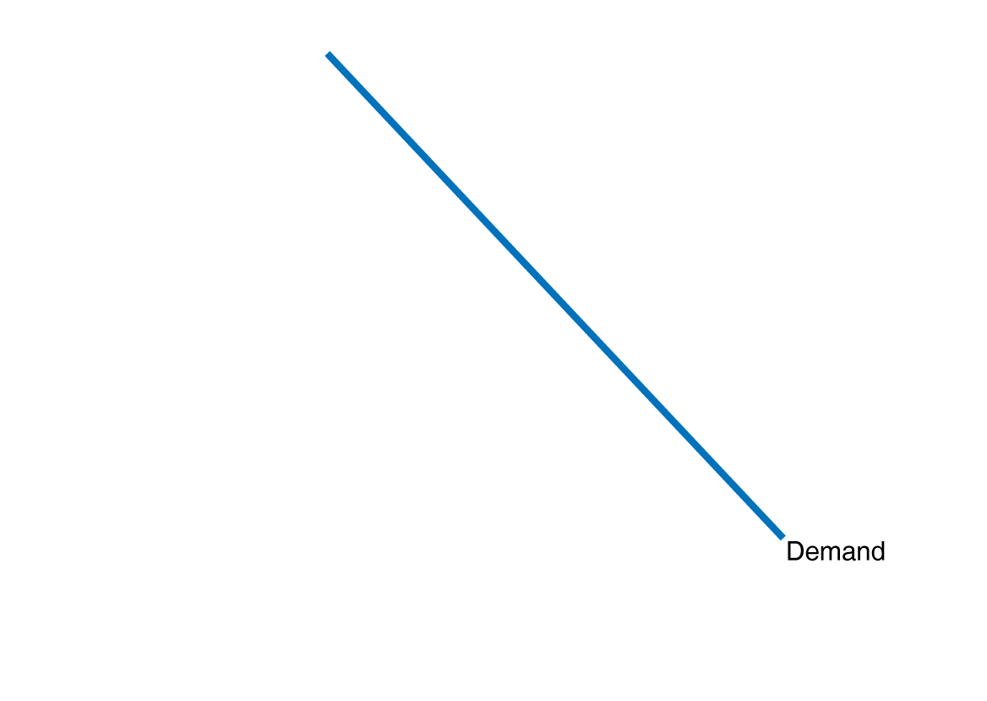
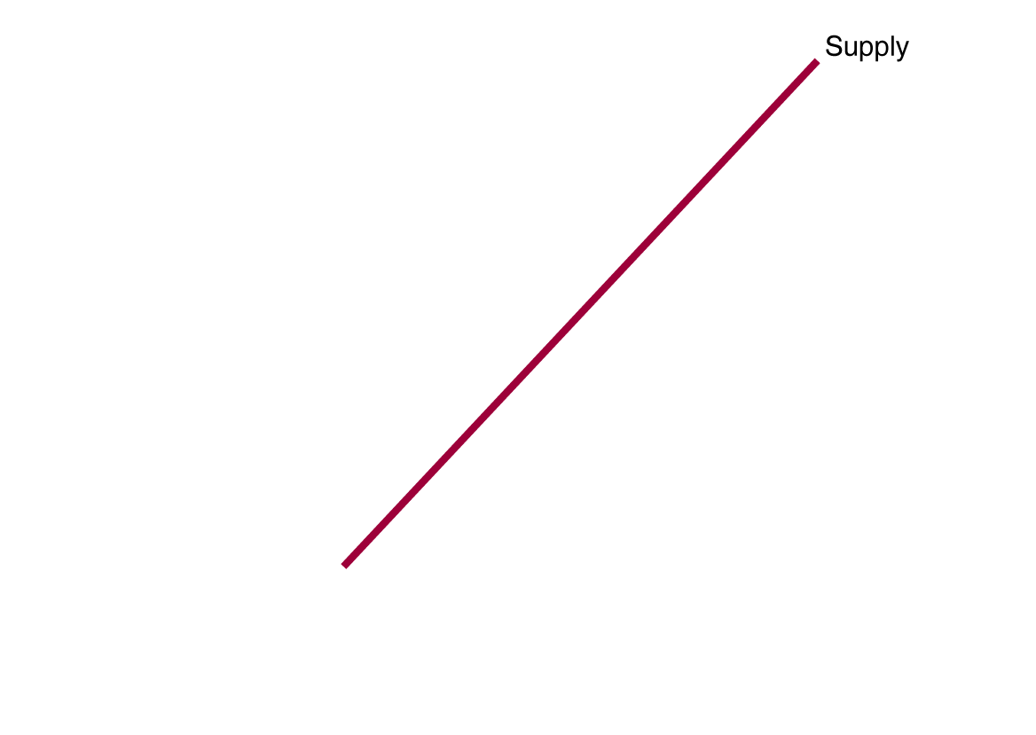
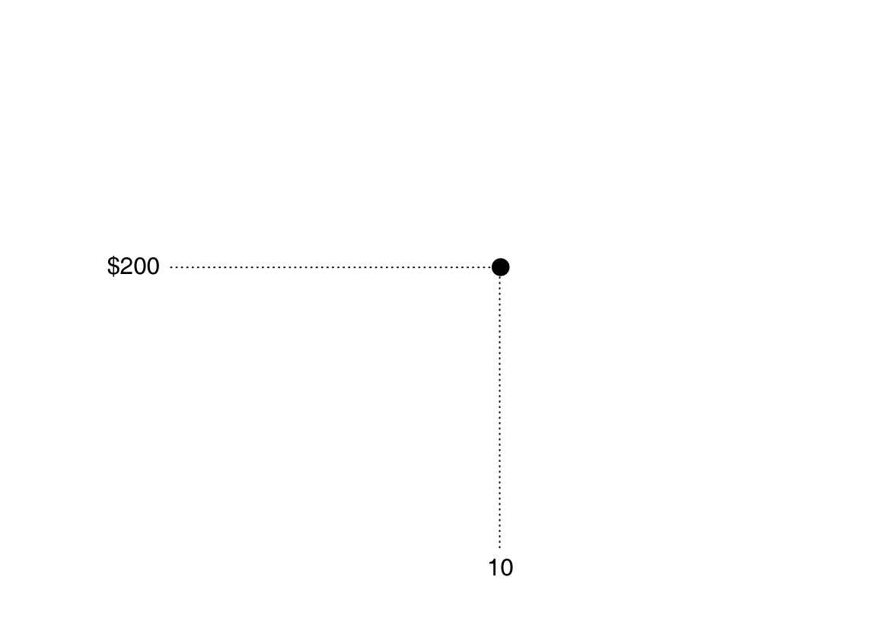
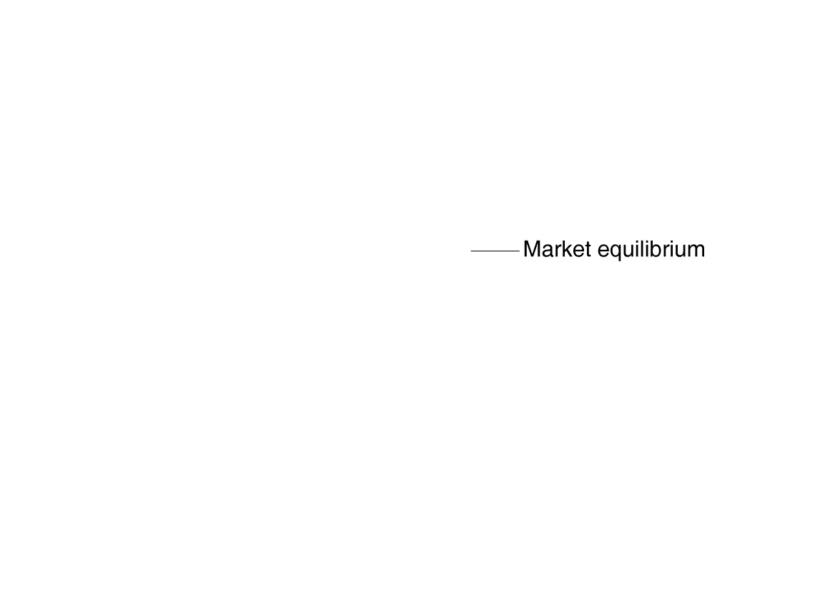
Market equilibrium
At a price of $200,
consumers want to buy 10 million smartphones, and
producers want to sell 10 million smartphones.
This is a market equilibrium: a situation in which quantity demanded equals quantity supplied.
A market equilibrium with many buyers and sellers is a competitive market equilibrium.
Figure 3.7
Market equilibrium
Notes:
Where the demand curve crosses the supply
curve determines market equilibrium.
In this case, the demand curve for
smartphones crosses the supply curve at a
price of $200 and a quantity of 10 million
smartphones. Only at this point is the quantity
of smartphones consumers are willing
to buy equal to the quantity that Apple,
Samsung,
LG, and other firms are willing to
sell: The quantity demanded is equal to the
quantity supplied.

Slide 32
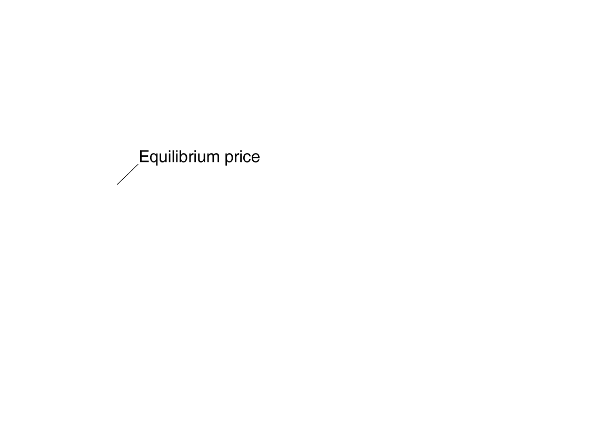
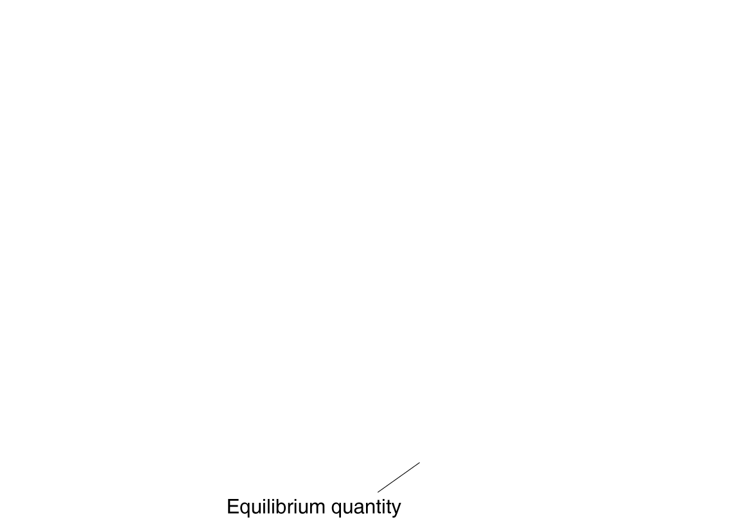
Market equilibrium price and quantity
In this market:
The equilibrium price of a smartphone is $200, and
The equilibrium quantity of a smartphone is 10 million smartphones per week.
Since buyers and sellers want to trade the same quantity at the price of $200, we do not expect the price to change.
Figure 3.7
Market equilibrium

Slide 33
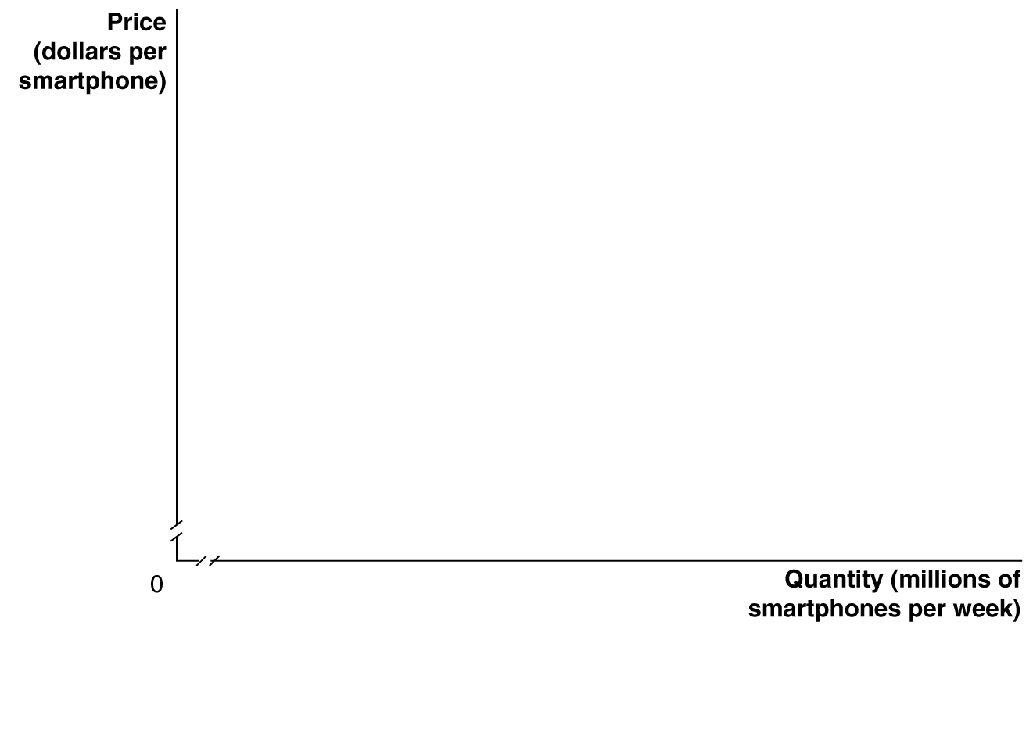
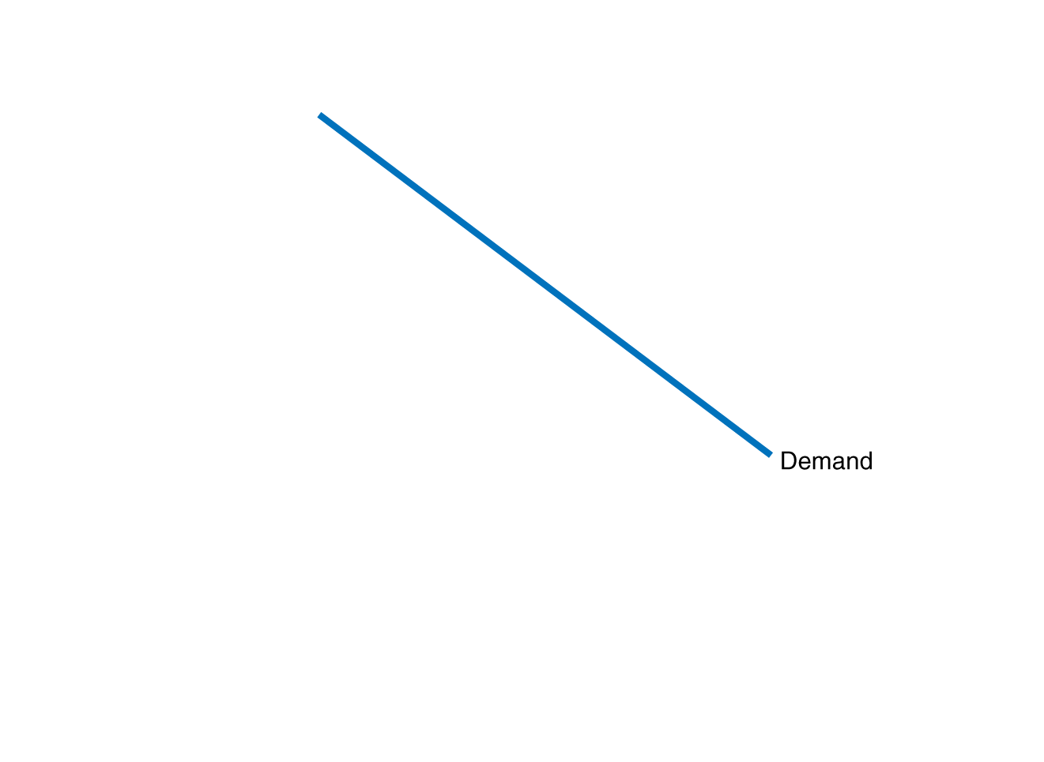
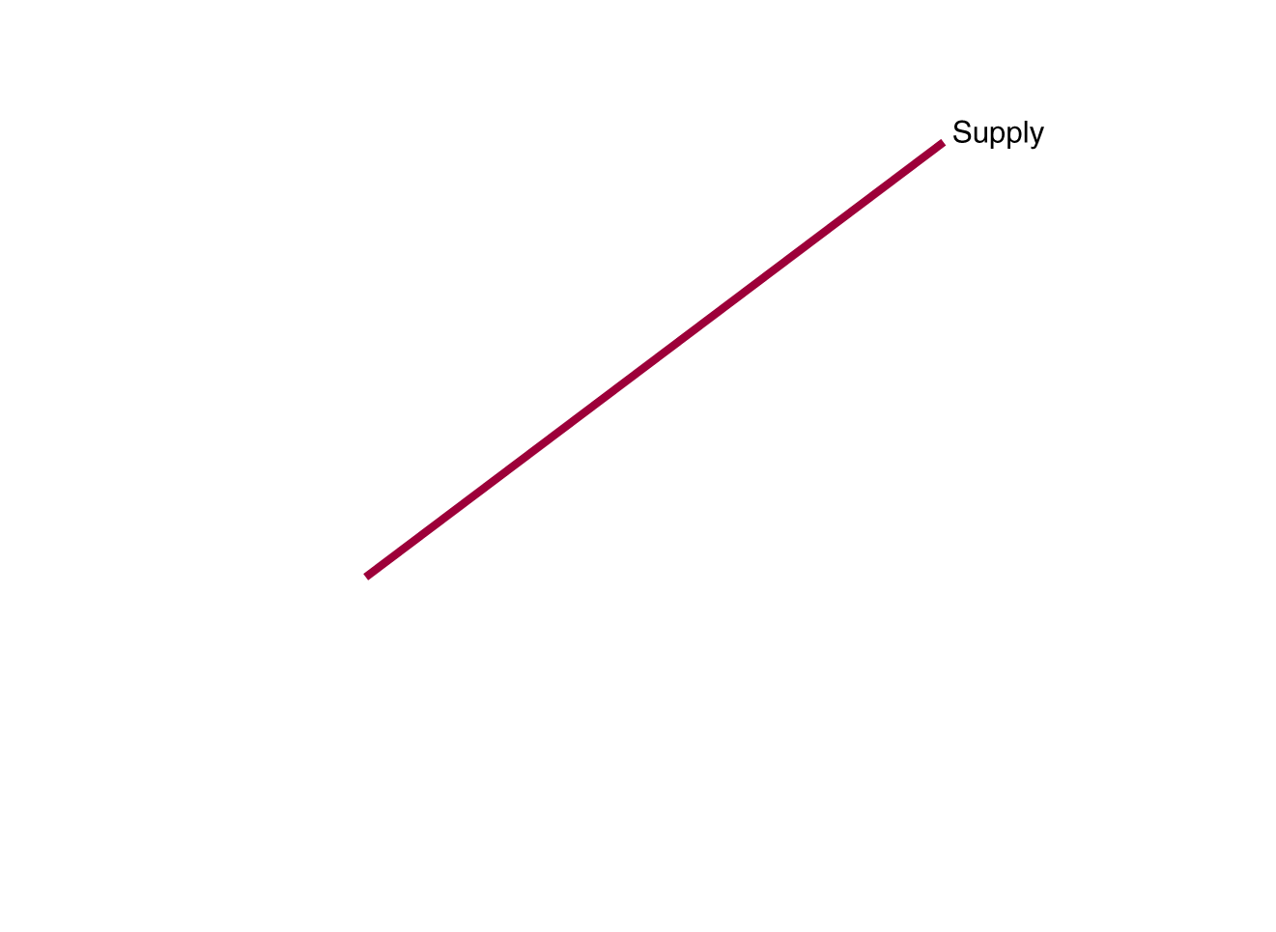
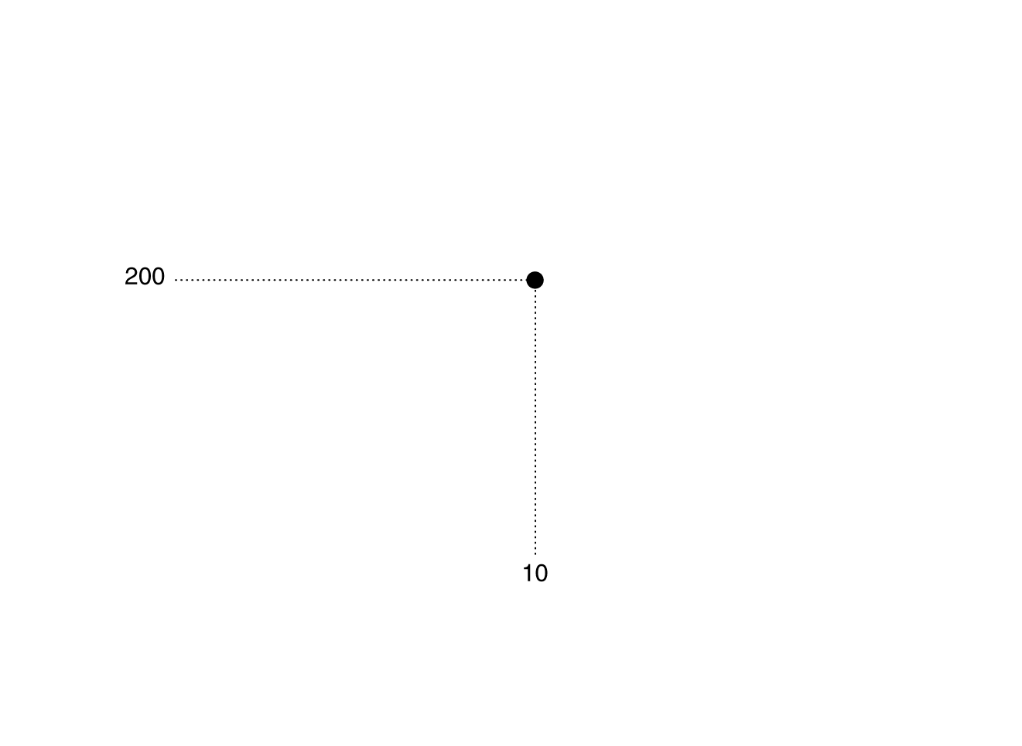
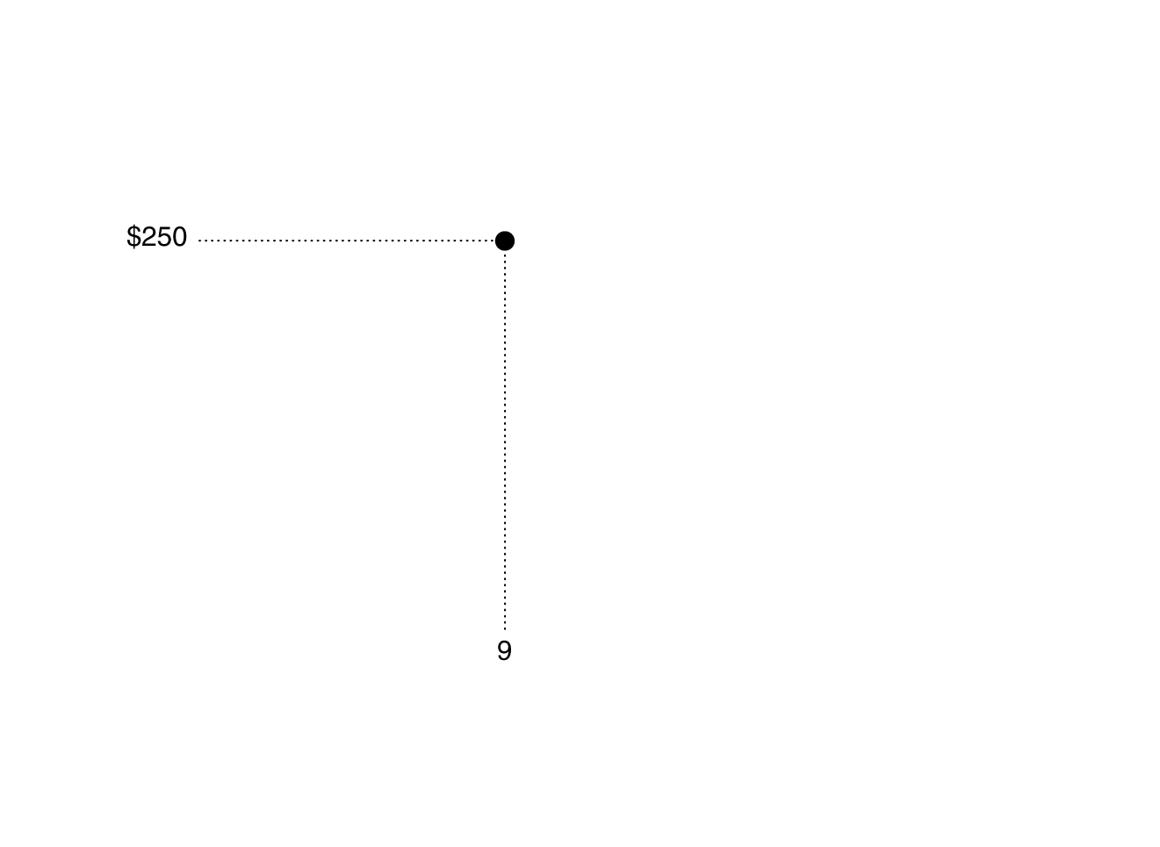


A surplus in the market for smartphones
At a price of $250,
consumers want to
buy 9 million
smartphones, while
producers want to
sell 11 million.
This gives a surplus of 2 million smartphones: a situation in which quantity supplied is greater than quantity demanded.
Prediction: sellers will compete amongst themselves, driving the price down.
Figure 3.8
The effect of surpluses and shortages on the market price
Notes:
When the market price is above equilibrium,
there will be a surplus. A price of $250
for smartphones results in 11 million smartphones
being supplied but only 9 million
being demanded, or a surplus of 2 million.
As Apple, Nokia, LG, and other firms cut the
price to dispose of the surplus, the price will
fall to the equilibrium of $200. When the
market price is below equilibrium, there will
be a shortage. A price of $100 results in 12
million smartphones being demanded but
only 8 million being supplied, or a shortage
of 4 million. As firms find that consumers
who are unable to find smartphones available
for sale are willing to pay higher prices
to get them, the price will rise to the equilibrium
of $200.

Slide 34



A shortage in the market for smartphones
At a price of $100,
consumers want to
buy 12 million
smartphones, while
producers want to
sell 8 million.
This gives a shortage of 4 million smartphones: a situation in which quantity demanded is greater than quantity supplied.
Prediction: sellers will realize they can increase the price and still sell as many smartphones, so the price will rise.
Figure 3.8
The effect of surpluses and shortages on the market price

Slide 35
Demand and supply both count
Price is determined by the interaction of buyers and sellers.
Neither group can dictate price in a competitive market (i.e. one with many buyers and sellers).
However changes in supply and/or demand will affect the price and quantity traded.

Slide 36
The Effect of Demand and Supply Shifts on Equilibrium
3.4
Use demand and supply graphs to predict changes in prices and quantities.

Slide 37
The usefulness of the demand and supply model
Predictions about price and quantity in model require us to know supply and demand curves.
Typically, we know price and quantity, but do not know the curves that generate them.
The power of the demand and supply model is in its ability to predict directional changes in price and quantity traded.

Slide 38









The effect of shifts in supply on equilibrium
Suppose Amazon enters the smartphone market:
More smartphones are supplied at any given price—an increase in supply from S₁ to S₂.
Equilibrium price falls from P₁ to P₂.
Equilibrium quantity rises from Q₁ to Q₂.
Figure 3.9
The effect of an increase in supply on equilibrium
Notes:
If a firm enters a market, as Amazon is
expected to enter the market for smartphones,
the equilibrium price will fall, and
the equilibrium quantity will rise:
1. As Amazon enters the market for
smartphones, a larger quantity of
smartphones will be supplied at every
price, so the market supply curve shifts
to the right, from S1 to S2, which causes
a surplus of smartphones at the original
price, P1.
2. The equilibrium price falls from P1 to P2.
3. The equilibrium quantity rises from Q1
to Q2.

Slide 39
How much will price and quantity change?
By how much will price fall? By how much will quantity rise?
We cannot say, without knowing more information.
For now, we can only predict that price will fall and quantity traded will rise.
Figure 3.9
The effect of an increase in supply on equilibrium

Slide 40









The effect of shifts in demand on equilibrium
Suppose incomes increase. What happens to the equilibrium in the smartphone market?
Smartphones are a normal good, so as income rises, demand shifts to the right (D₁ to D₂).
Equilibrium price rises (P₁ to P₂).
Equilibrium quantity rises (Q₁ to Q₂).
Figure 3.10
The effect of an increase in demand on equilibrium
Notes:
Increases in income will cause the equilibrium
price and quantity to rise:
1. Because smartphones are a normal
good, as income increases, the quantity
demanded increases at every price, and
the market demand curve shifts to the
right, from D1 to D2, which causes a
shortage of smartphones at the original
price, P1.
2. The equilibrium price rises from P1 to P2.
3. The equilibrium quantity rises from Q1
to Q2.

Slide 41
Effects of changes in demand or supply
The table summarizes what happens when the demand curve shifts or the supply curve shifts, with the other curve remaining unchanged.
 | Supply Curve Unchanged | Supply Curve Shifts to the Right | Supply Curve Shifts to the Left
Demand Curve Unchanged | Q unchanged P unchanged | Q increases P decreases | Q decreases P increases
Demand Curve Shifts to the Right | Q increases P increases
Demand Curve Shifts to the Left | Q decreases P decreases
Table 3.3
How shifts in demand and supply affect equilibrium price (P) and quantity (Q)

Slide 42








Shifts in demand and supply over time
Over time, it is likely that both demand and supply will change.
For example, as new firms enter the market for smartphones and incomes increase, we expect
The supply of smartphones will shift to the right, and
The demand for smartphones will shift to the right.
Figure 3.11a
Shifts in demand and supply over time: demand shifting more than supply
Notes:
Whether the price of a product rises or falls over time depends on whether demand
shifts to the right more than supply.
In panel (a), demand shifts to the right more than supply, and the equilibrium
price rises:
1. Demand shifts to the right more than supply.
2. The equilibrium price rises from P1 to P2.
In panel (b), supply shifts to the right more than demand, and the equilibrium
price falls:
1. Supply shifts to the right more than demand.
2. The equilibrium price falls from P1 to P2.

Slide 43



Demand shifting more than supply
What does our model predict?
S↑ → ( P↓ and Q↑ )
D↑ → ( P↑ and Q↑ )
So we can be sure equilibrium quantity will rise; but the effect on equilibrium price is not clear.
This panel shows demand shifting more than supply: equilibrium price and quantity both rise.
Figure 3.11a
Shifts in demand and supply over time: demand shifting more than supply

Slide 44











Supply shifting more than demand
This panel shows supply shifting more than demand: quantity rises, but equilibrium price falls.
Without knowing the relative size of the changes, the effect on equilibrium price is ambiguous.
It is possible, but unlikely, that the equilibrium price will remain unchanged.
Figure 3.11b
Shifts in demand and supply over time: supply shifting more than demand

Slide 45
Effect of changes in demand or supply—redux
We can now fill in the rest of Table 3.3.
The cell in red is the example that we just did.
 | Supply Curve Unchanged | Supply Curve Shifts to the Right | Supply Curve Shifts to the Left
Demand Curve Unchanged | Q unchanged P unchanged | Q increases P decreases | Q decreases P increases
Demand Curve Shifts to the Right | Q increases P increases | Q increases P increases or decreases | Q increases or decreases P increases
Demand Curve Shifts to the Left | Q decreases P decreases | Q increases or decreases P decreases | Q decreases P increases or decreases
Table 3.3
How shifts in demand and supply affect equilibrium price (P) and quantity (Q)

Slide 46
The falling price of Blu-ray players
From 2006 to 2013, the price of Blu-ray players fell from about $800 to about $95, while the number of Blu-ray players traded increased dramatically.
What best explains this change?
Increase in demand
Decrease in demand
Increase in supply
Decrease in supply
Can you show this change on a supply-and-demand diagram?

Slide 47






Blu-ray players (part B)
Supply increased as additional firms started manufacturing Blu-ray players and input costs fell.

Slide 48
Shifts of a curve vs. movements along a curve
Suppose an increase in supply occurs. We now know:
Equilibrium quantity will increase, and
Equilibrium price will decrease
It is tempting to believe the decrease in price will cause an increase in demand. But this is incorrect.
The decrease in price will cause a movement along with demand curve, but not an increase in demand.
Why? The demand curve already describes how much of the good consumers want to buy, at any given price.
When the price change occurs, we just look at the demand curve to see what happens to how much consumers want to buy.

Slide 49
Common misconceptions to avoid
Mixing up terminology: movement along the curve (caused by price change) vs. shifting the curve (caused by other changes).
Not moving curves far enough to be able to illustrate a change.
  Exaggerating curve shifts is okay.
Incompletely labeling diagrams.
  Use your arrows!
Being certain of both price and quantity changes when both demand and supply curves move.
  Only one of these effects will be certain.

